Slide 1
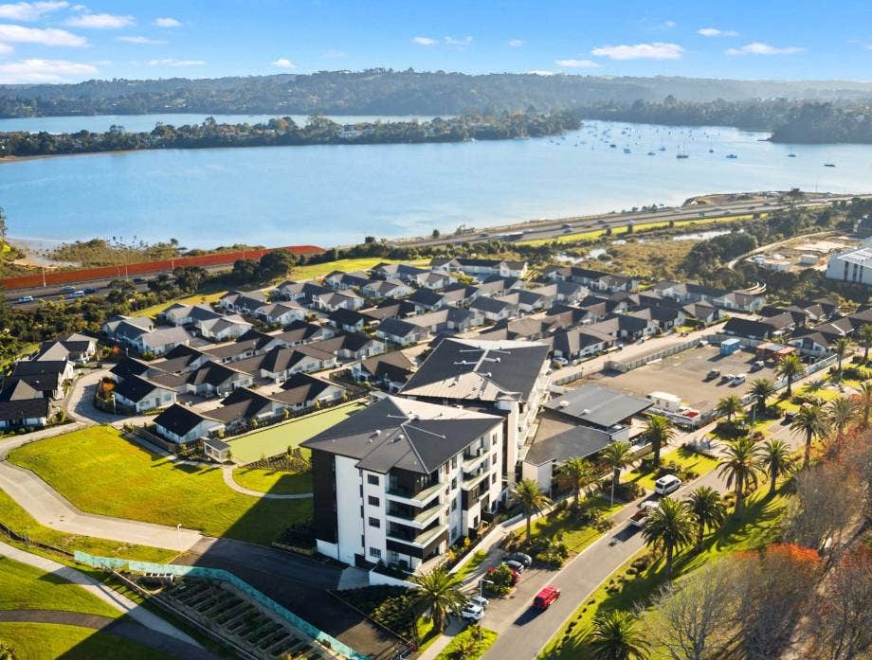


Aged Care Business For Meeting The Needs Of Today’s Society.
Oceania Healthcare
(NZE: OCA)
HOLD
1 year Target Price
NZ$ 0.81
Upside: 3.9%
Last Close (9/20/2023): $0.77
AUT Team
Wendy
Swarnima
Nurul
Notes:
Summarize the whole presentation:
OCA is a
Our DCF valuation gives a 1-year target price of $0.81, which is a 3.9% upside.

Slide 2
INVESTMENT THESIS
INVESTMENT THESIS
Aging population
Growing demand from aging population
Aging population | Longer life expectancy
Short-term business challenges
HOLD
Soft Aged Care Margin| Lower Sales Volume | Higher Cost of Debt
1-year Target Price
NZ$ 0.81
Uncertainty in short-term environment
Longer High Interest Rate | Slow Down Housing Market |Inflation | Labour Workforce
Business Model
Industry Positioning
Financial Analysis
Valuation-DCF
Sensitivity Analysis
ESG
Appendix Table
Notes:
Demand is quantified.

Slide 3


BUSINESS MODEL – 2 SEGMENTS
Segment 1
Segment 2
AGED CARE (Rest Homes, Hospitals, Dementia Care) |  |  | RETIREMENT VILLAGE (Independent Living)
Standard Bed | PAC Bed | Care Suite | Apartment, Villa
n/a | PAC | ORA (30% DMF) | ORA (30% DMF)
Government funded care fee |  |  | Weekly fee
2639 units of care bed & suite in 2023
(59%)
1820 units of village in 2023
(41%)
Source: Company data
Business Model
Industry Positioning
Financial Analysis
Valuation-DCF
Sensitivity Analysis
ESG
Appendix Table
Notes:
Key takeaway:
Two segments in OCA: aged care, retirement village
Difference is aged care services (4 level of care) & independent living (hospitality)
Aged care rely on government funding
Rest home care cost - $1272
Hospital, Dementia care cost - $1272 + DHB S
WINZ revises the care fees in July each year.
PAC has more space, outdoor access and other premium features.

Slide 4
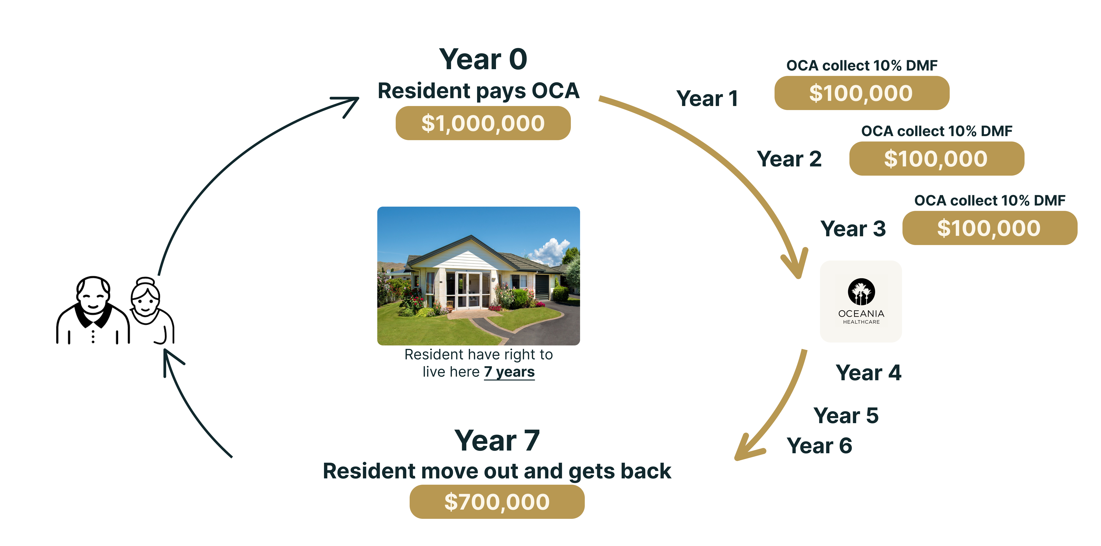
BUSINESS MODEL – ORA EXPLANATION
Occupancy Right Agreement (ORA) Explanation
Received total $300,000 as DMF
DMF (30% ORA) + Weekly fee + Other service fee = Retirement Village Revenue
Also, in addition to all above revenue streams, OCA earns Development Margin in each unit sale, which is 35% currently. The development margin contributes to EBITDA of OCA under village revenue segment.
Source: Company data
Business Model
Industry Positioning
Financial Analysis
Valuation-DCF
Sensitivity Analysis
ESG
Appendix Table
Notes:
Key Takeaway:
How ORA & DMF works and why it is important to business
Interest part: lump sum collect from new ORA is an interest free funding

Slide 5
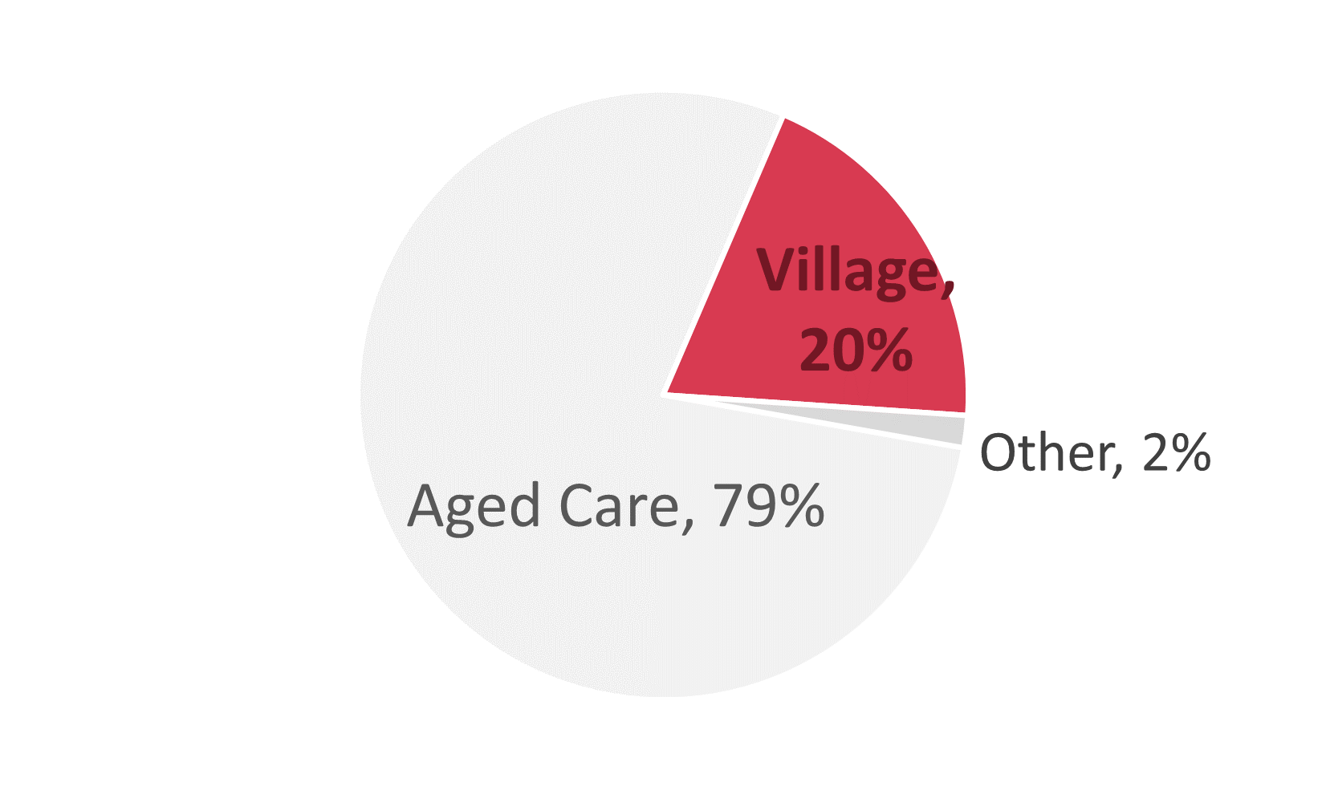
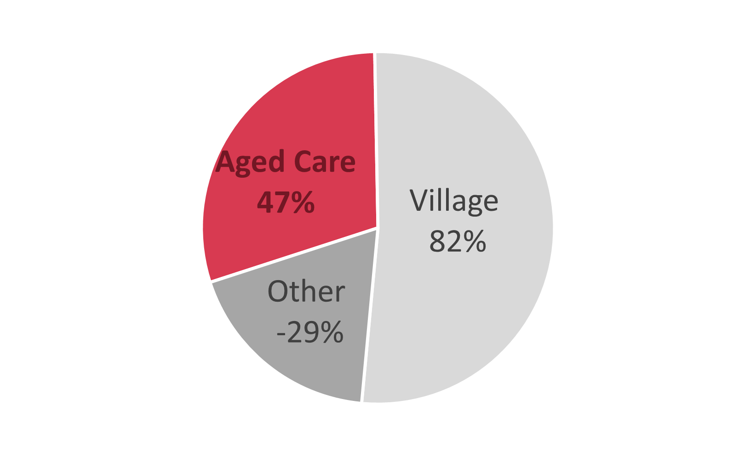
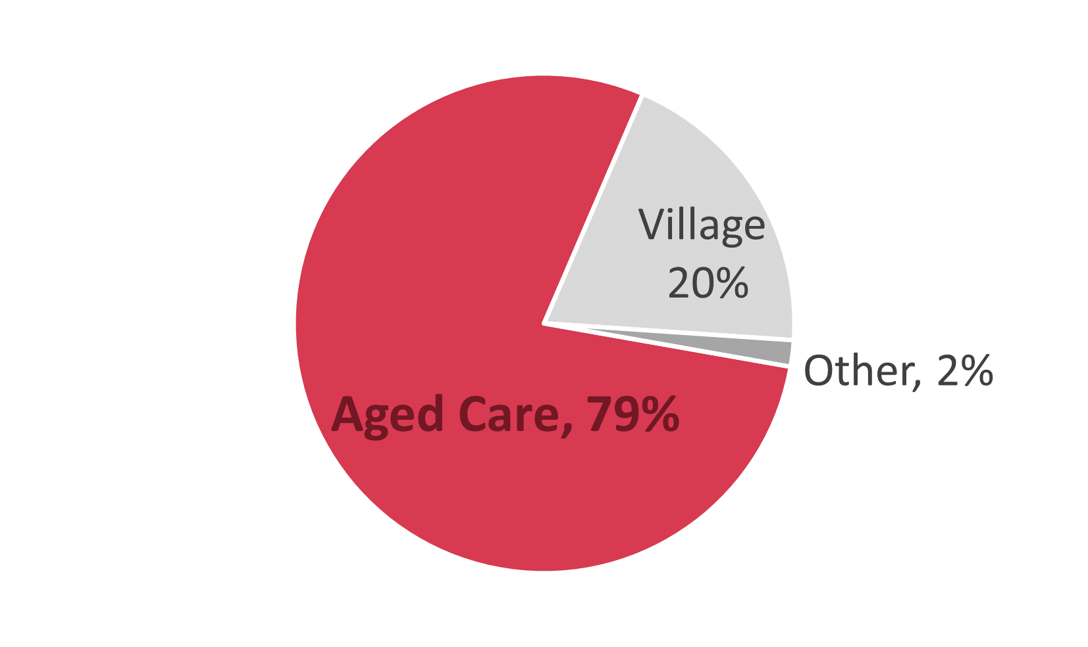
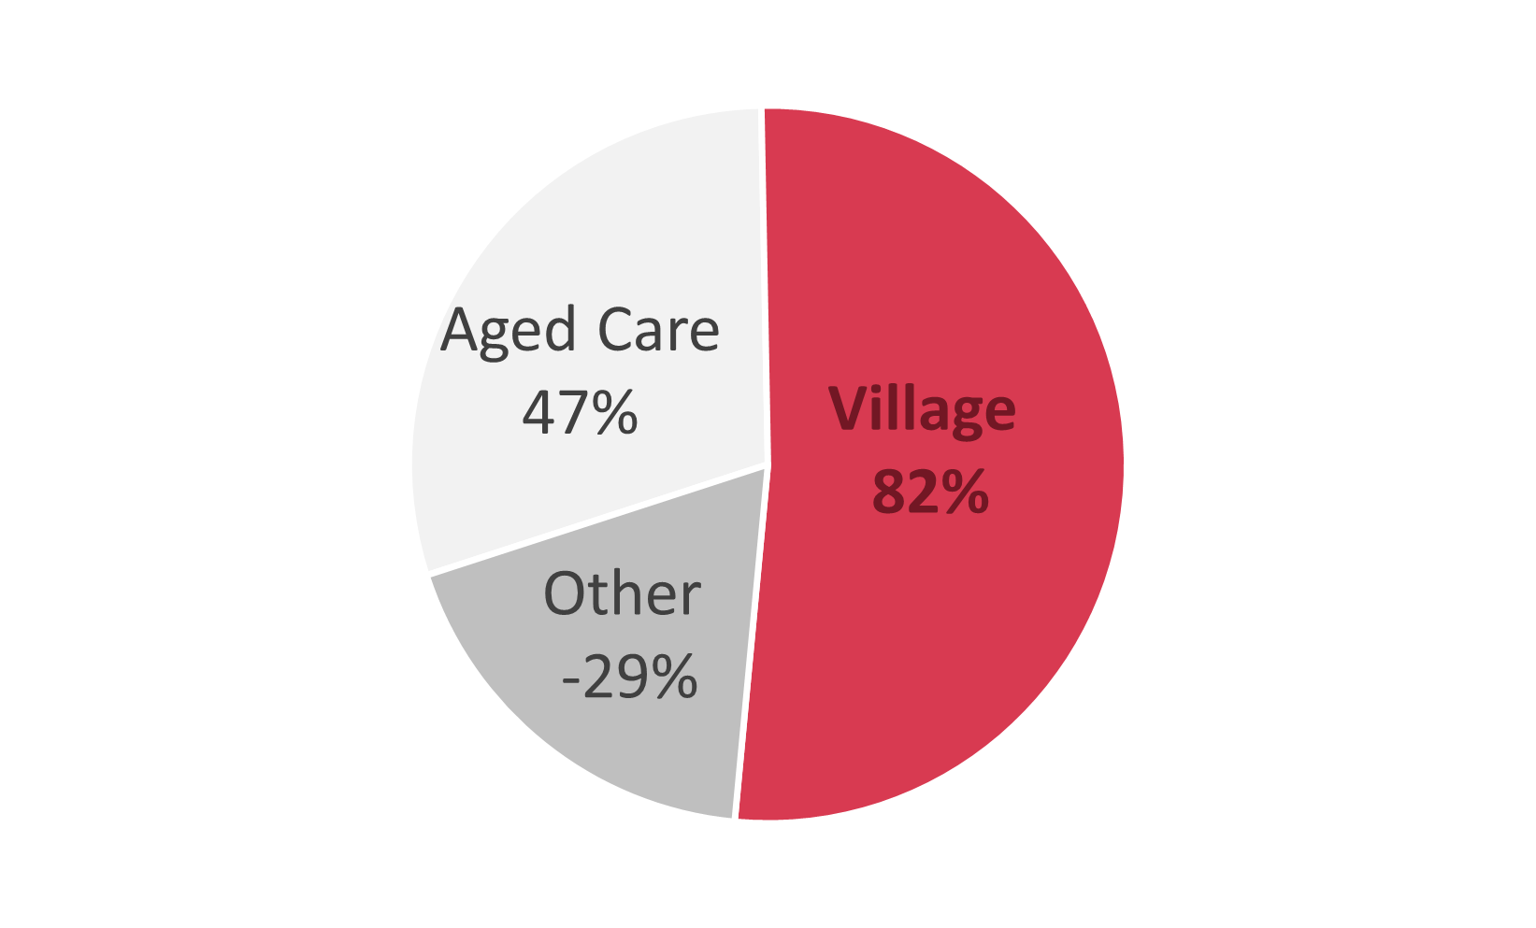
FINANCIAL ANALYSIS
We see two stories in OCA stock:
GROWTH in Retirement Village
We see two stories in OCA stock:
VALUE in Aged Care
% contribution of Revenue in 2023
% contribution of EBITDA in 2023
Adding these two stories together with headwinds we recommend HOLD.
We see two stories in OCA stock:
1) Value Part – The aged care segment of OCA.
2) Growth Part - The Retirement village segment of OCA with a good margin in business model.
Adding these two stories together with headwinds we recommend HOLD.
Lower revenue contribution from Retirement Village
High revenue contribution from aged care
Lower EBITDA contribution from aged care
High EBITDA contribution from Retirement Village
Aged Care segment of OCA with a 79% revenue contribution.
Retirement village segment of OCA with a good margin in business model.
Source: Company data
Business Model
Industry Positioning
Financial Analysis
Valuation-DCF
Sensitivity Analysis
ESG
Appendix Table
Notes:
Value in aged care: high revenue but low EBITDA
Growth in retirement village: lower revenue contribution but high EBITDA

Slide 6
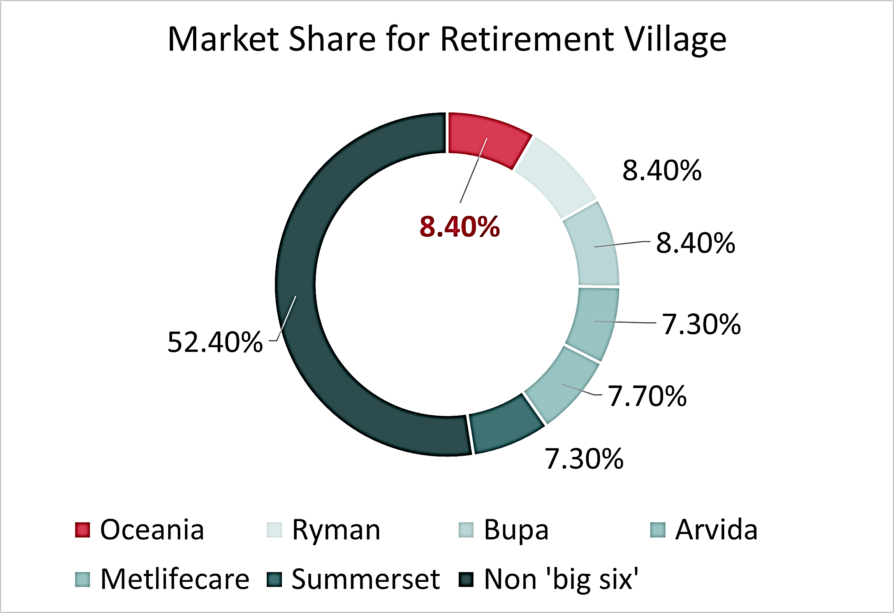
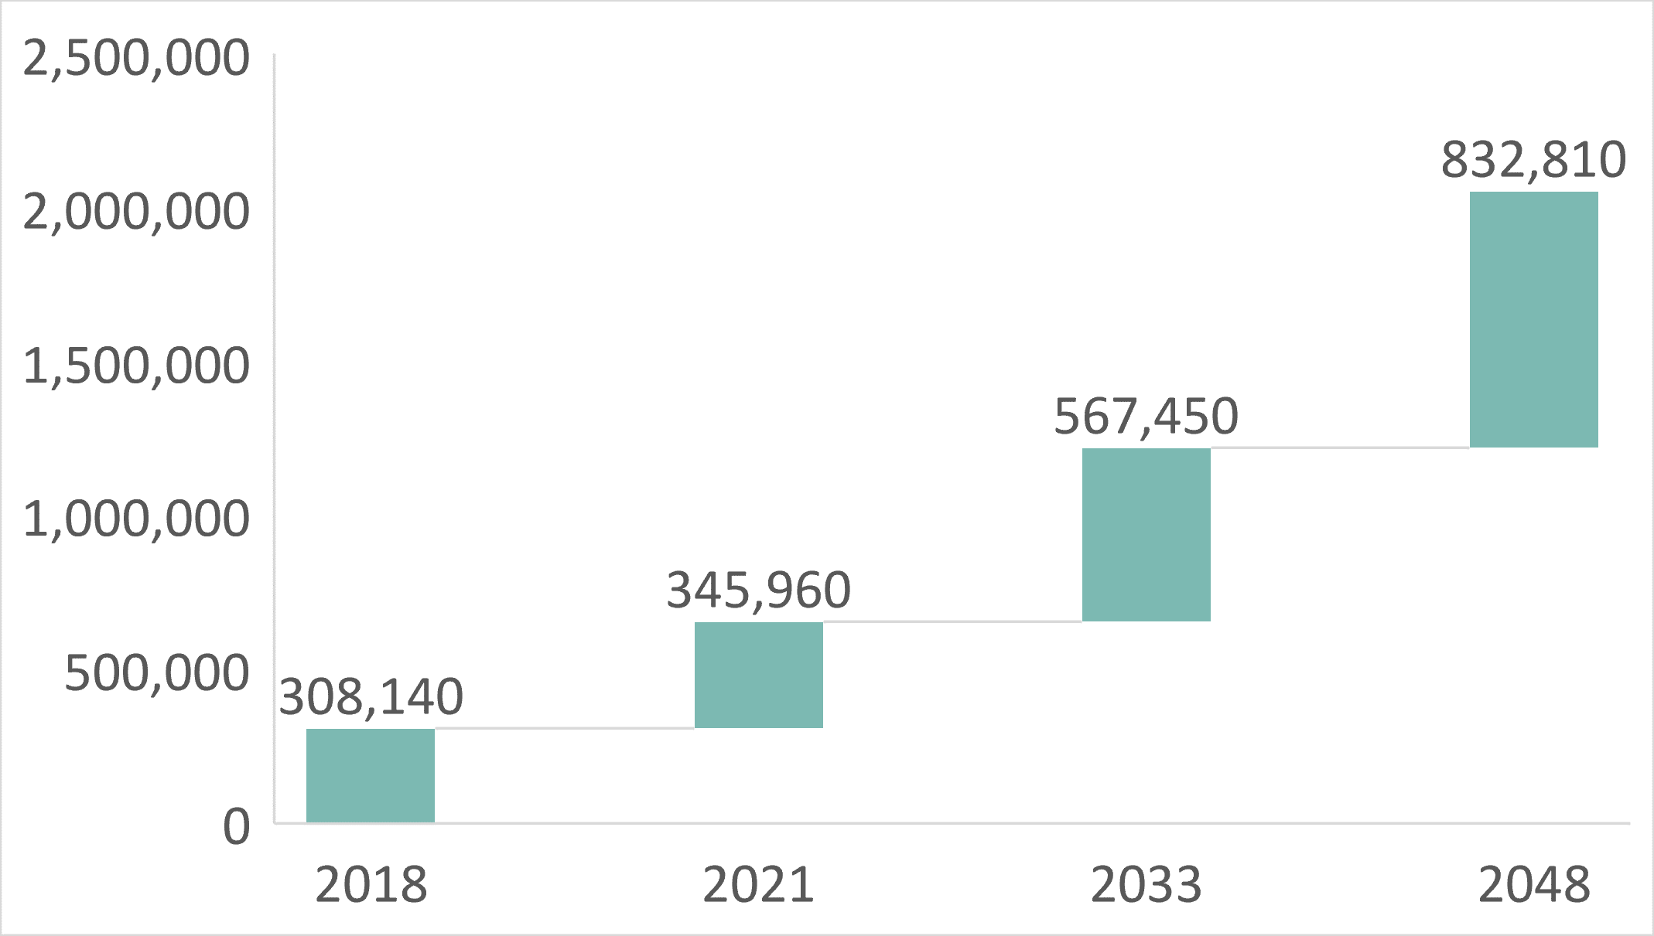
INDUSTRY POSITIONING
Players in Retirement Village Industry
Market Demand Projection
NZ 75+ age group growth until 2048
By 2043, 75+ age group reach 760k, 98.1% increase in 20 years. In context, the numbers translates to 15.94% of NZ population.
Total market size in NZ: 5.5b NZD
OCA current market cap: 528.63m NZD
Expect a shortfall of 11,608 village units by 2033.
Source: JIL.NZ
Business Model
Industry Positioning
Financial Analysis
Valuation-DCF
Sensitivity Analysis
ESG
Appendix Table
Notes:
Demand is quantified.

Slide 7
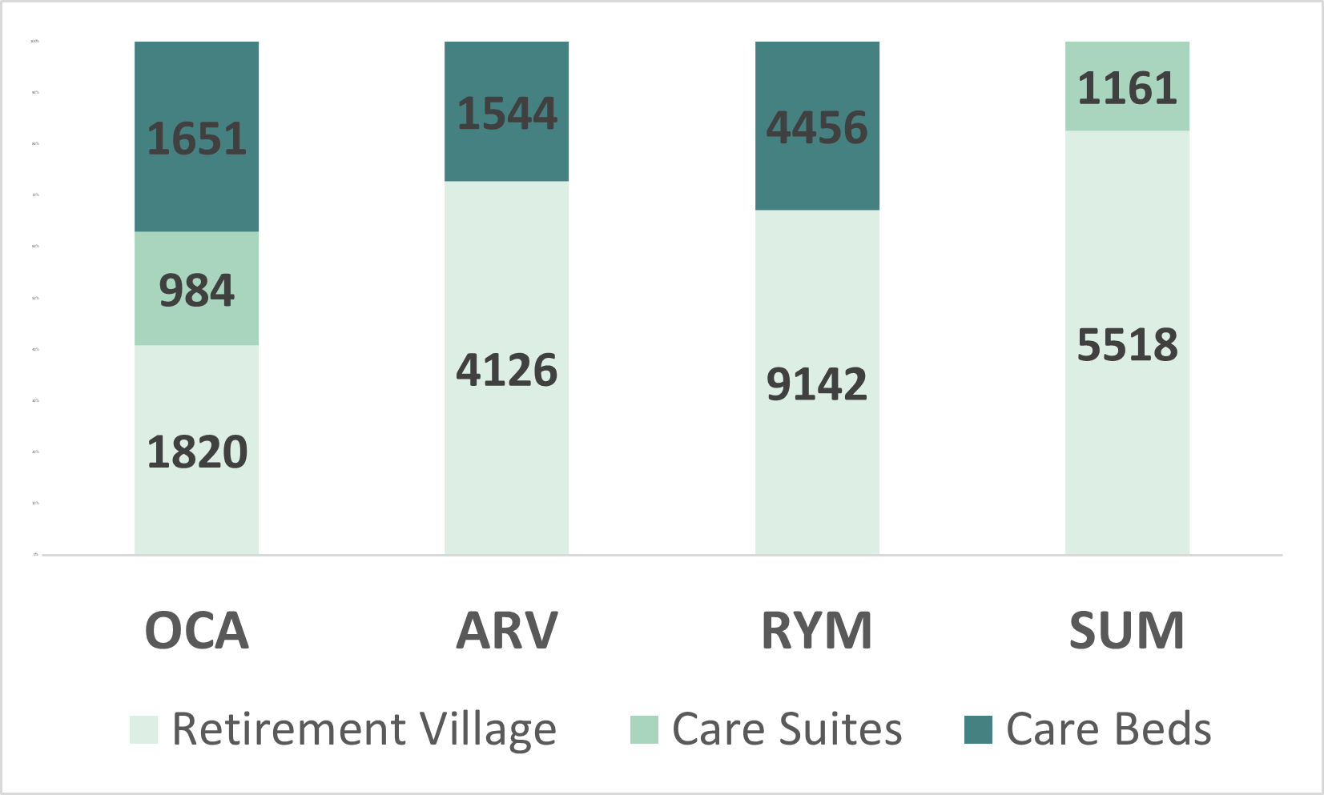
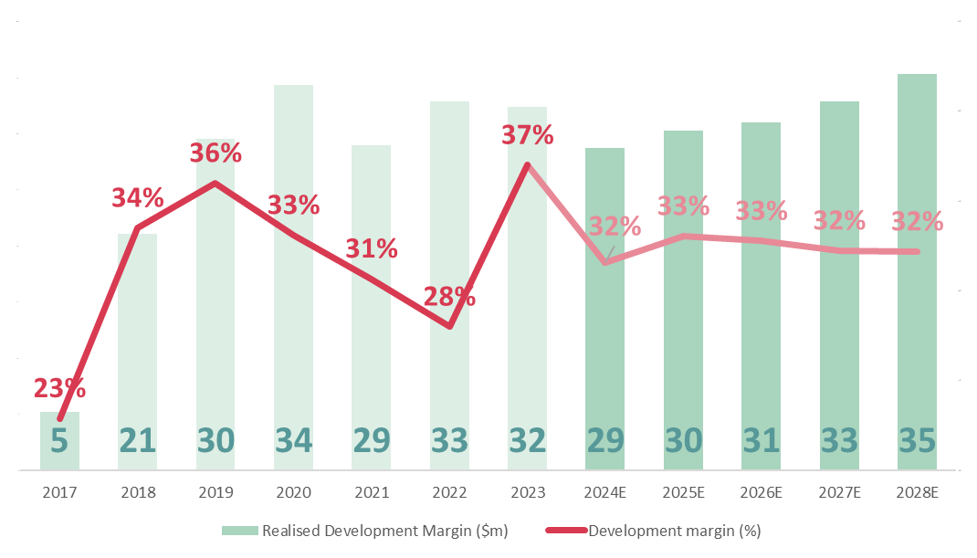
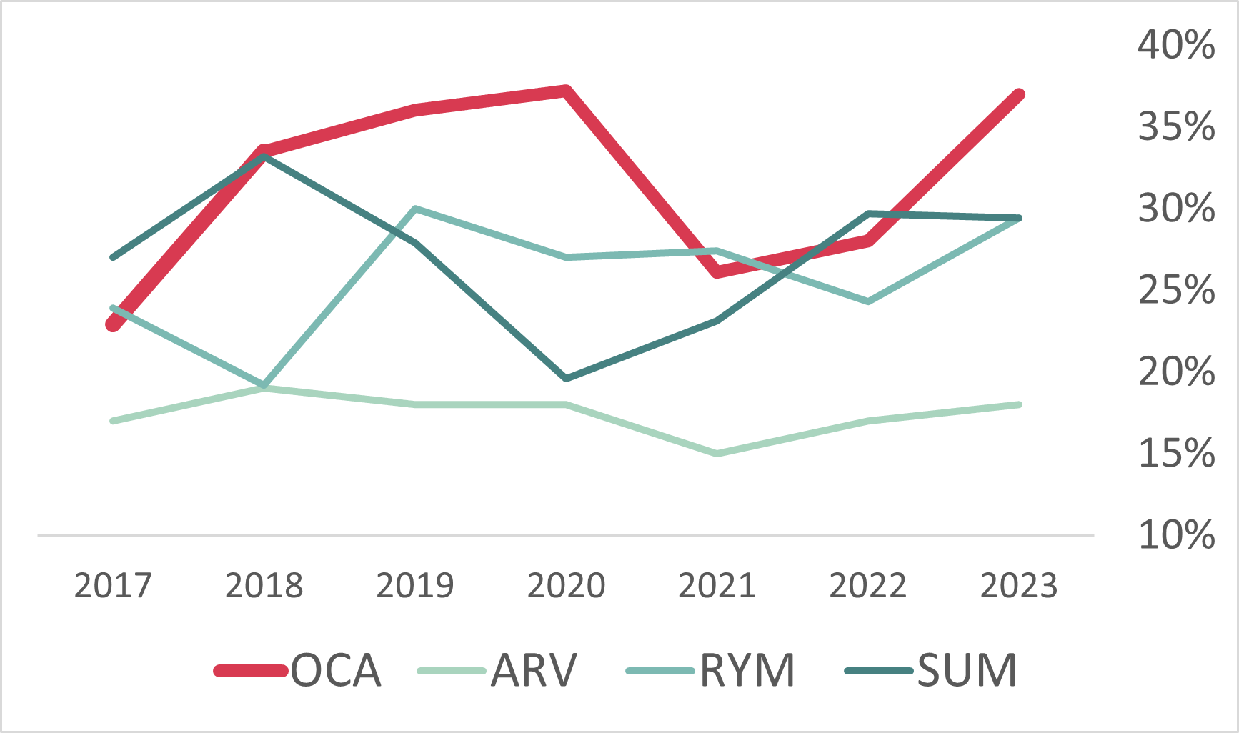
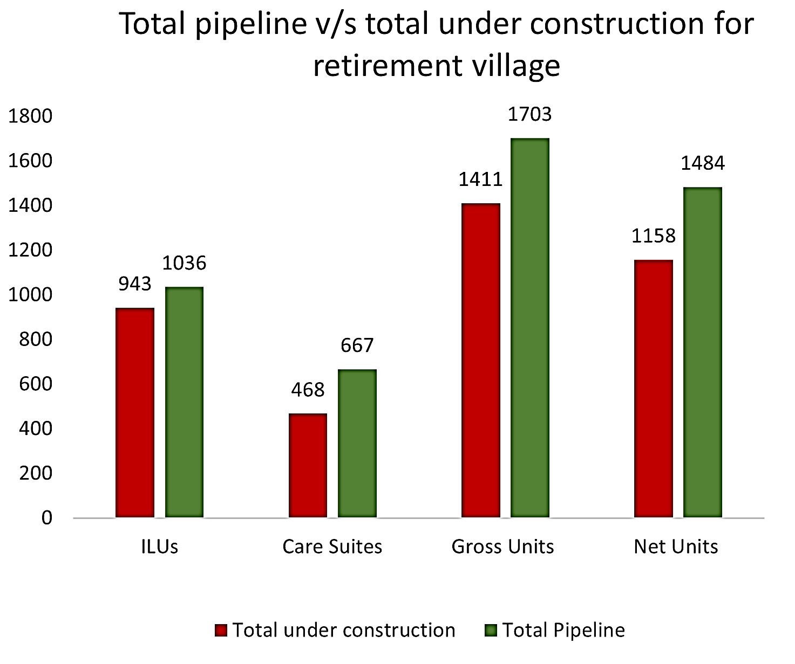
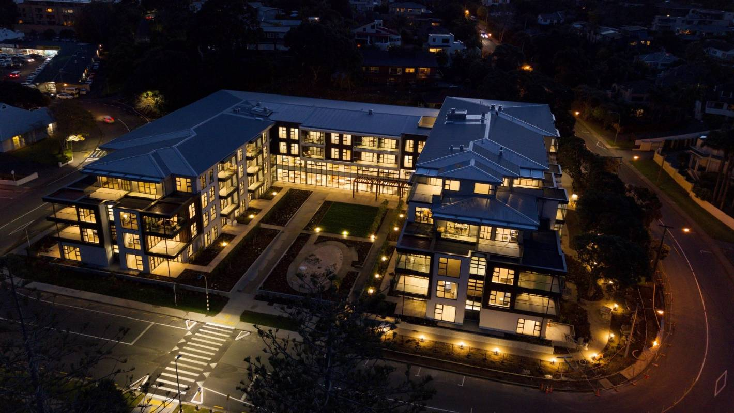
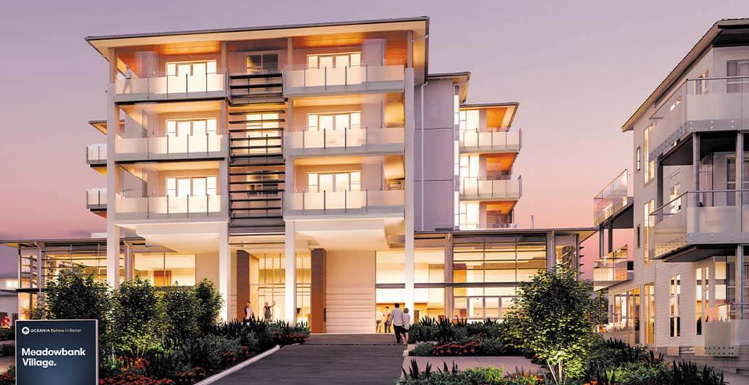
COMPETITIVE POSITION
Luxury Retirement Village
OCA development margin (%) compared to Peers 2017-2023
OCA Development Margin 2017-2028
Luxury Retirement Village | No. of Units
The Helier | 62
Remuera Rise | 70
Eden | 154
The Sands | 108
the BayView | 215
Green Gables | 101
The Bellevue | 93
m
m
m
m
m
m
m
m
m
m
m
m
Delivering 943 ILU units for the next few years
Luxury offering - The Helier with 62 units and 79 suites, was valued at $150m in 2022.
OCA Meadowbank Retirement village
OCA The Sands aged care and retirement village in Browns Bay
Source: Company data
Business Model
Industry Positioning
Financial Analysis
Valuation-DCF
Sensitivity Analysis
ESG
Appendix Table
Notes:
Demand is quantified.

Slide 8
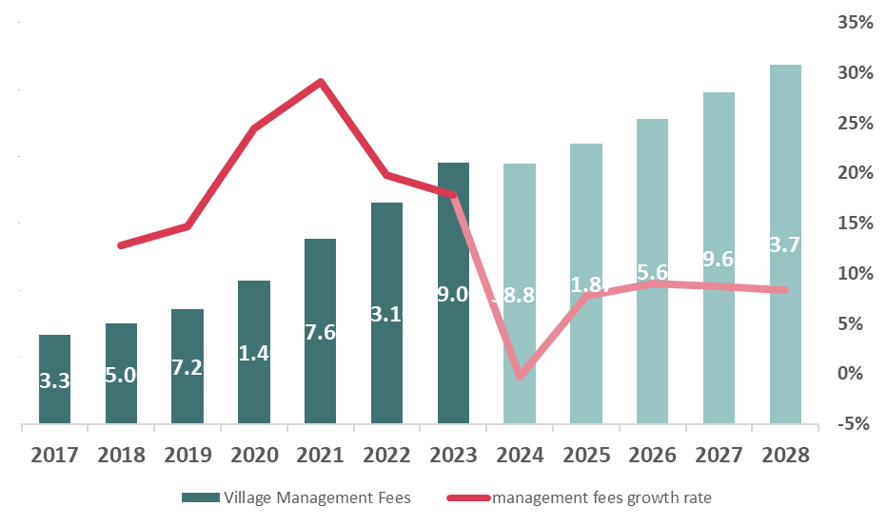
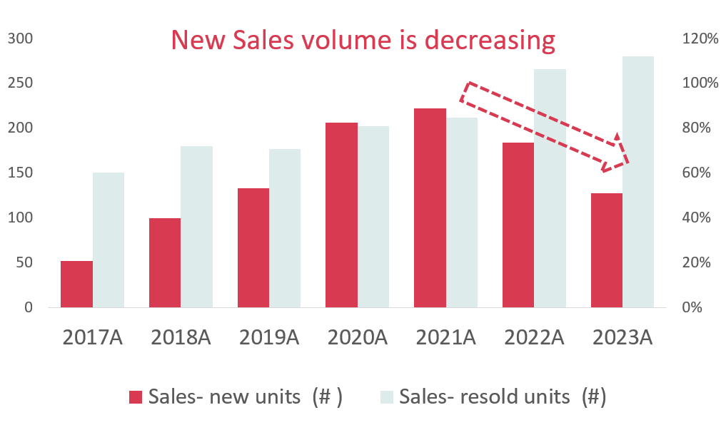
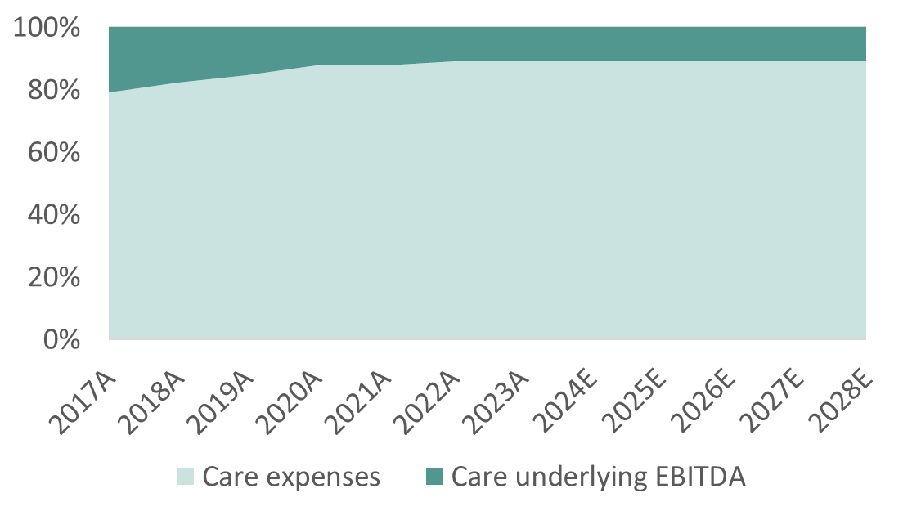
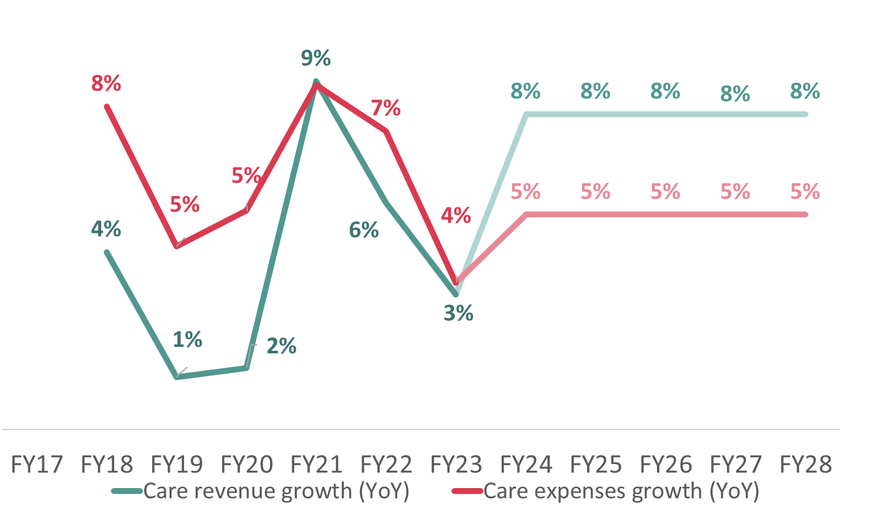
PROFITABILITY
Inflation and rising nurse wages are driving up expenses.
Government funded care fee restricts revenue growth.
The sales have been affected by the current housing market conditions and higher interest rates
Soft Margin in Aged Care
Village Sales Performance
Care Expenses growth (YoY) excess Revenue growth
Care uEBITDA Margin (%) 2017-2028
m
m
m
m
m
m
m
m
m
m
m
m
Source: Company data
Business Model
Industry Positioning
Financial Analysis
Valuation-DCF
Sensitivity Analysis
ESG
Appendix Table
Notes:
Key Takeaway:
OCA two segments are affected by current short-term environment
Aged care with soft margin driven by inflation, rising nurse wages, causing higher expenses growth rate; and government funded care fee causing slower growth in aged care revenue. From 2017 to 2023, we observed that the care expenses grow faster than revenue
Village profitability negatively affected by current housing market and interest rate. We observed the sales number of new unit keep decreasing started from 2021, which is also when the OCR started to rise. The sales performance further impacting the village revenue growth rate.

Slide 9
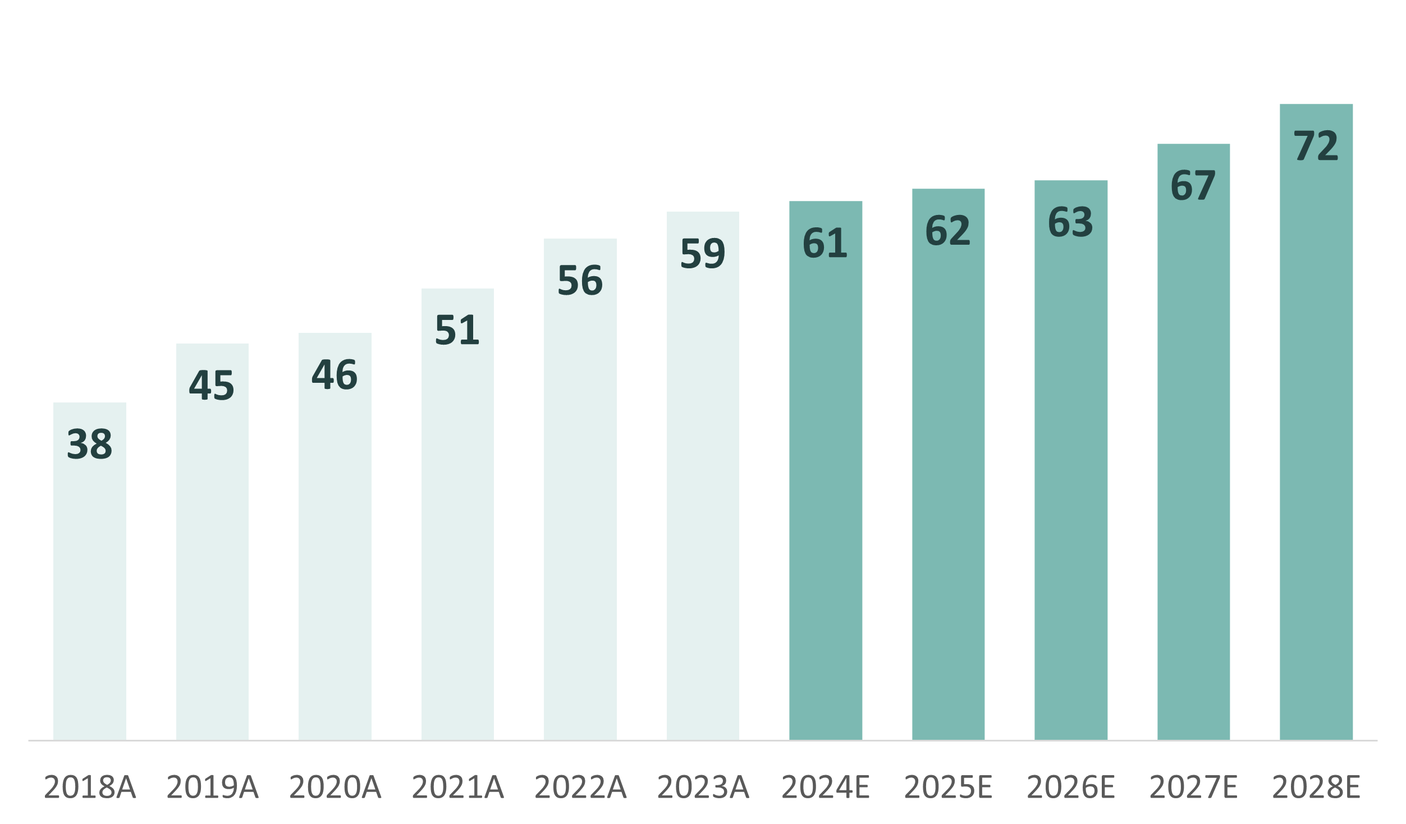
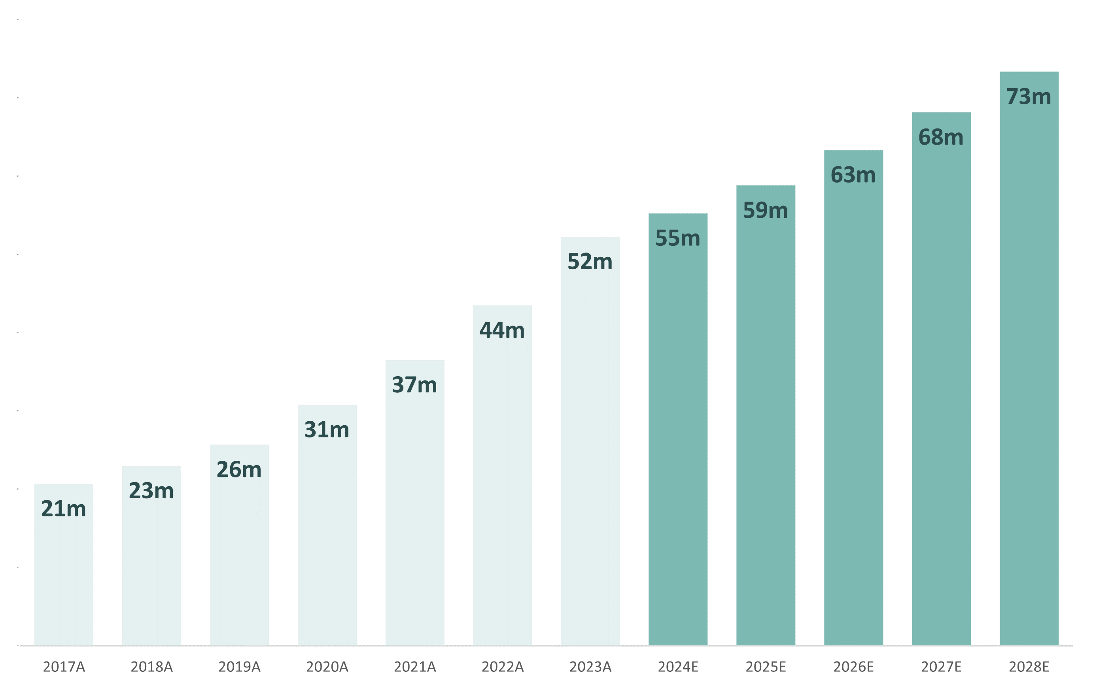
VAUATION – REVENUE PROJECTION
Village Revenue Projection
Total Sales Margin (New Sale + Resale) 2017-2028
Village Revenue from 2017-2028
8%
3.1% CAGR
8%
7.7% CAGR
8%
6%
6%
Growth (YoY)
Revenue Assumption
14% CAGR
Key Revenue Growth Factors:
Life Expectancy Growth Rate
Demand Growth Projection
(Population Growth)
GDP Growth Rate
Source: Company data
Business Model
Industry Positioning
Financial Analysis
Valuation-DCF
Sensitivity Analysis
ESG
Appendix Table
Notes:
We took those current short-term uncertainty into consideration and give a village revenue projection of 6 to 8% growth year on year.
Compared with a 14% CAGR in the past 7 years.
Also, as we have seen high interest rate with new residents delay their move in time, total sales margin we predict will be 3.1% CAGR for the next five years.

Slide 10
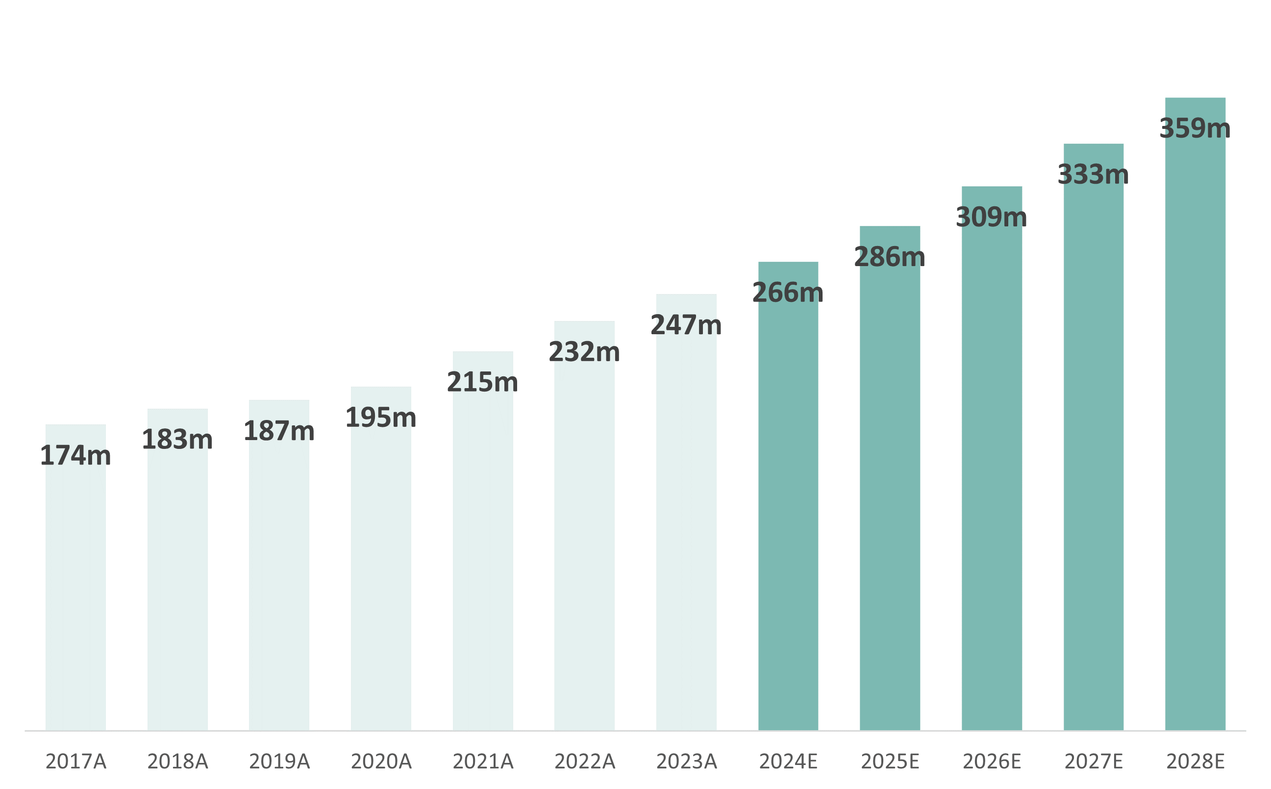
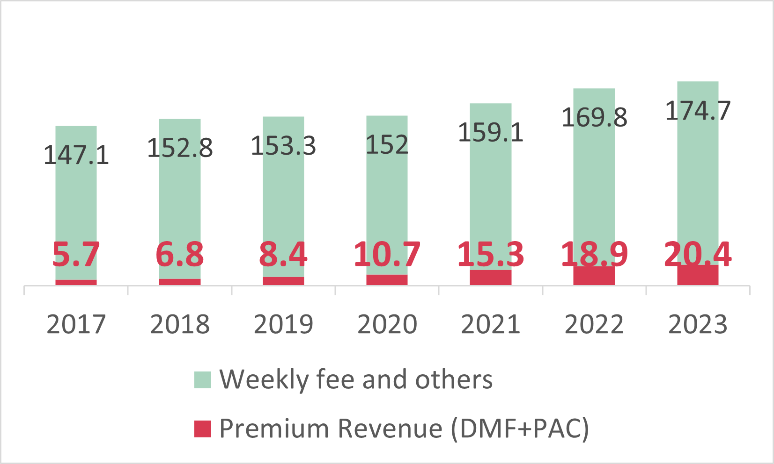
VALUATION – REVENUE PROJECTION
Aged Care Revenue projection
Revenue Assumption
Aged Care revenue from 2017-2028
Aged Care revenue ($m)breakdown from 2017-2023
2.5% CAGR
8%
8%
20% CAGR
8%
8%
8%
Growth (YoY)
5.2% CAGR
Growth weight assumption on aged care revenue
30% weight on premium revenue CAGR 20%
70% weight on care fee CAGR 2.5%
Source: Company data
Business Model
Industry Positioning
Financial Analysis
Valuation-DCF
Sensitivity Analysis
ESG
Appendix Table
Notes:
Aged care revenue is expected to growth faster with 8% growth rate year on year.
Although the care fee growth rate has a lower 2.5% CAGR in previous year, we believe with OCA’s oncoming new care suites, it will continue with its 20% CAGR on premium revenue.

Slide 11
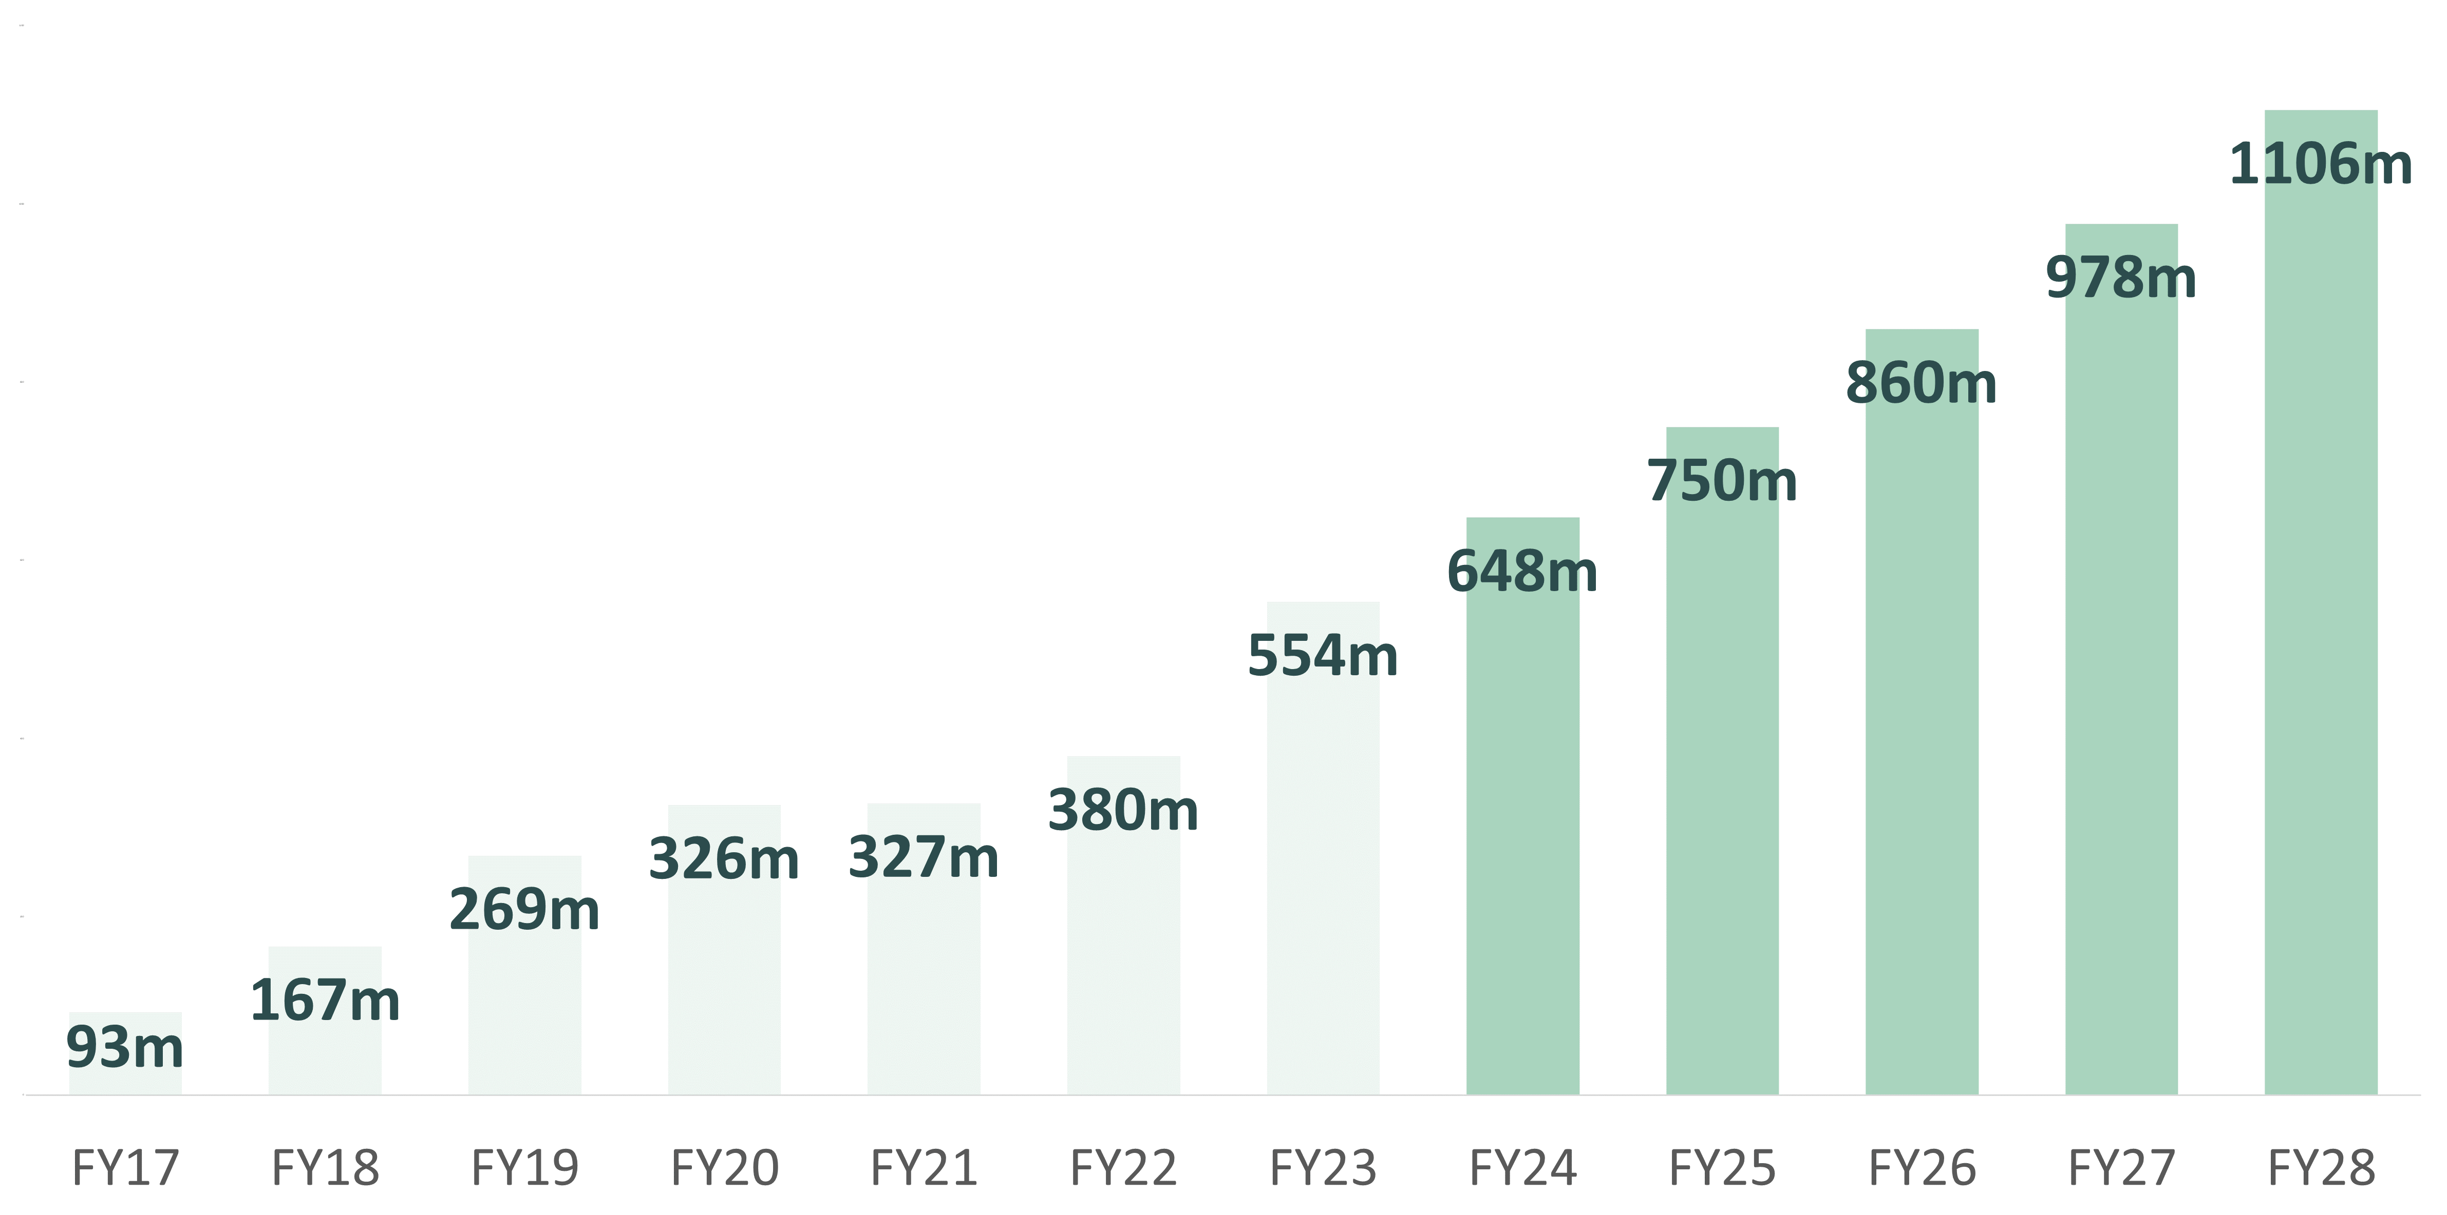
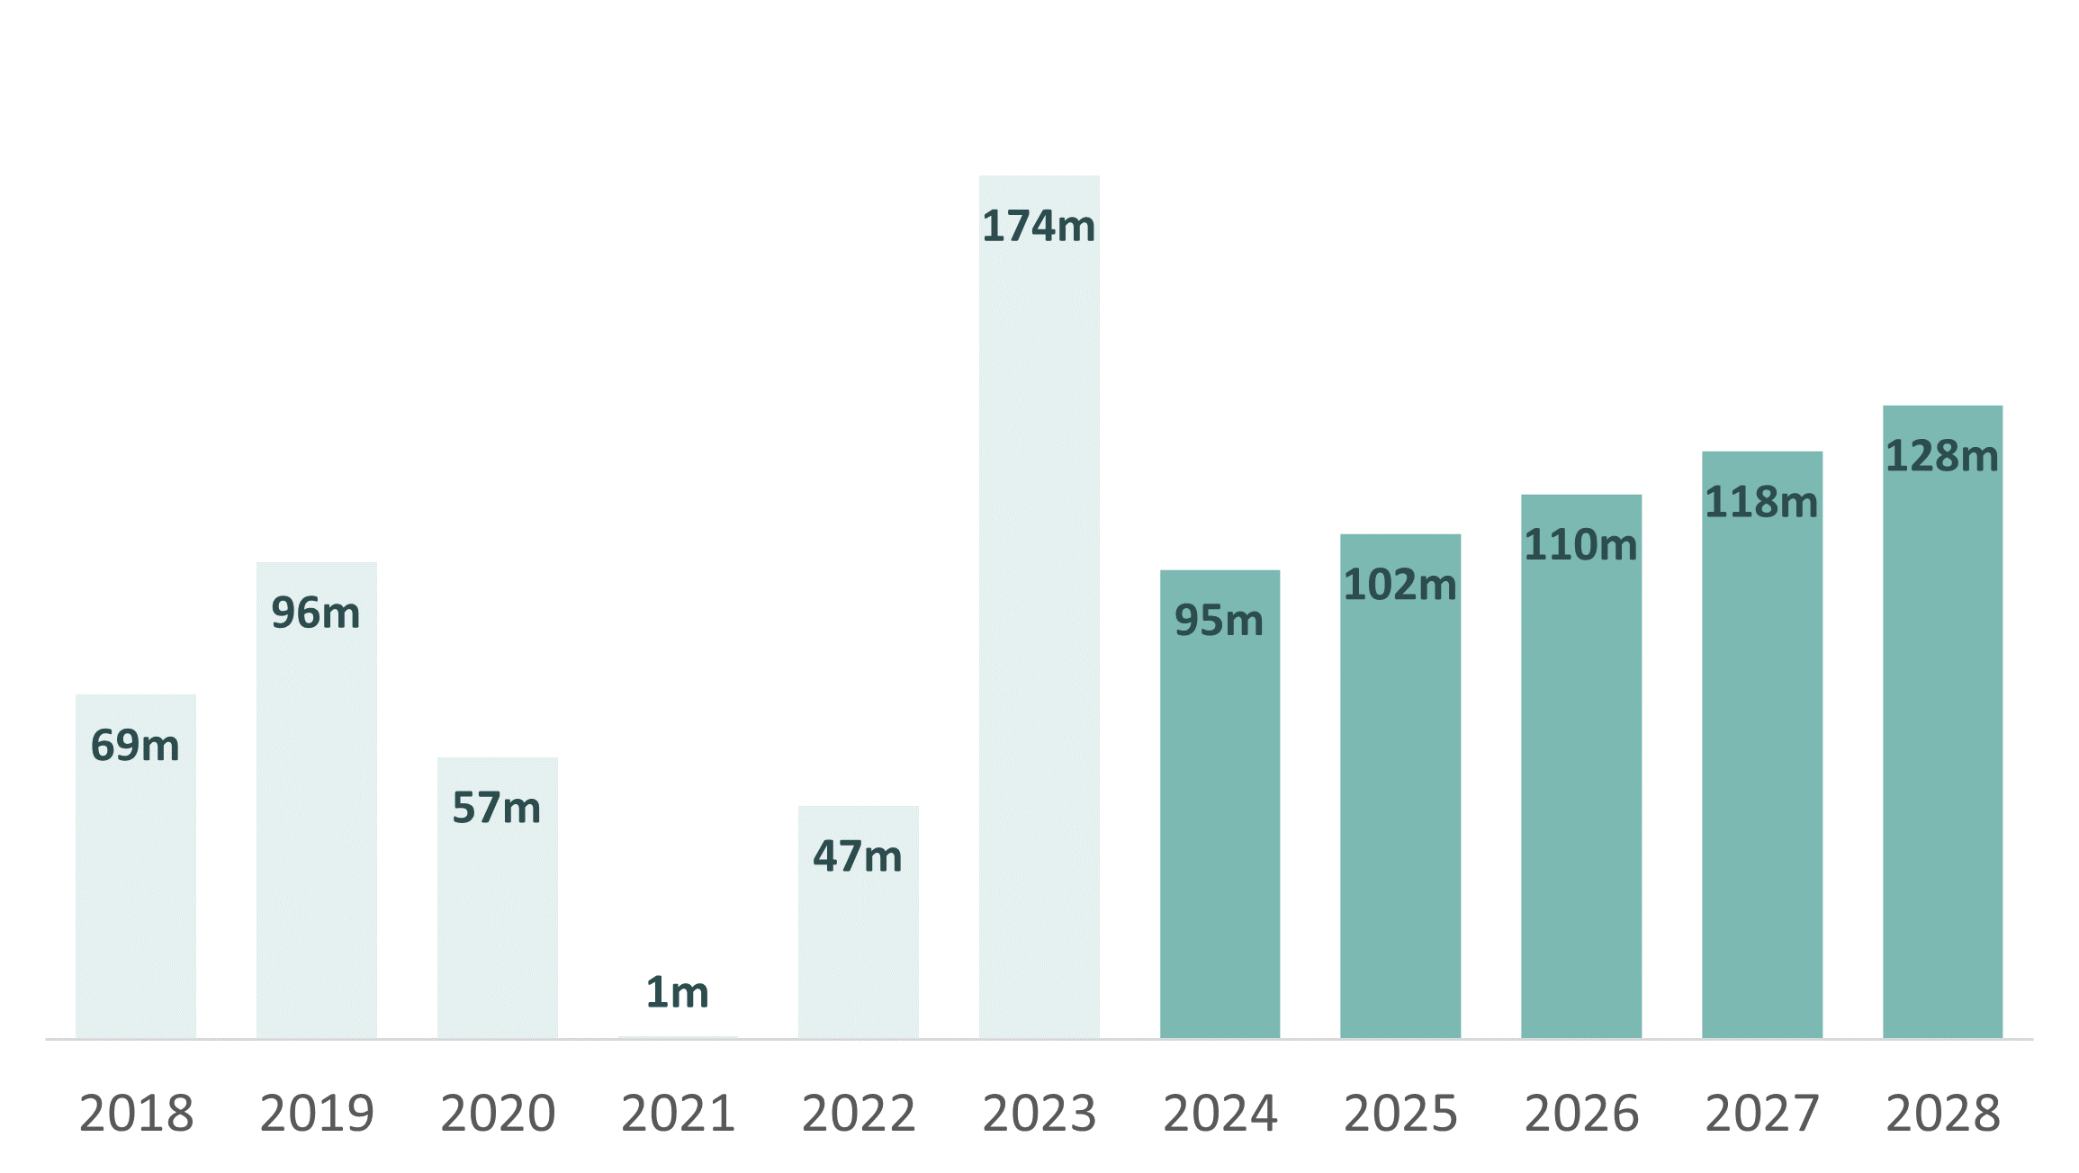
DEBT CAPACITY ANALYSIS
Total debt projection
Total debt Assumption
Total debt ($m) from 2017-2028
We believe OCA is a Capital-Intensive business:
Net increase in borrowing ($m) from 2017-2028
Average 36% of Net borrowing to revenue
12% CAGR
22% CAGR
We predict OCA will rise the net increase in borrowing by 36% of revenue each year.
Source: Company data
Business Model
Industry Positioning
Financial Analysis
Valuation-DCF
Sensitivity Analysis
ESG
Appendix Table
Notes:
As we mentioned the growing demand in aging population and OCA’s strategy on buying lands, building more units. We believe this is a capital intensity business.
We forecast OCA will keep growing their debt ,with 12% CAGR, to support their expanding strategy.
Our assumption of average 36% of net borrowing to revenue means we expect OCA’s total debt will grow follow by its revenue.

Slide 12

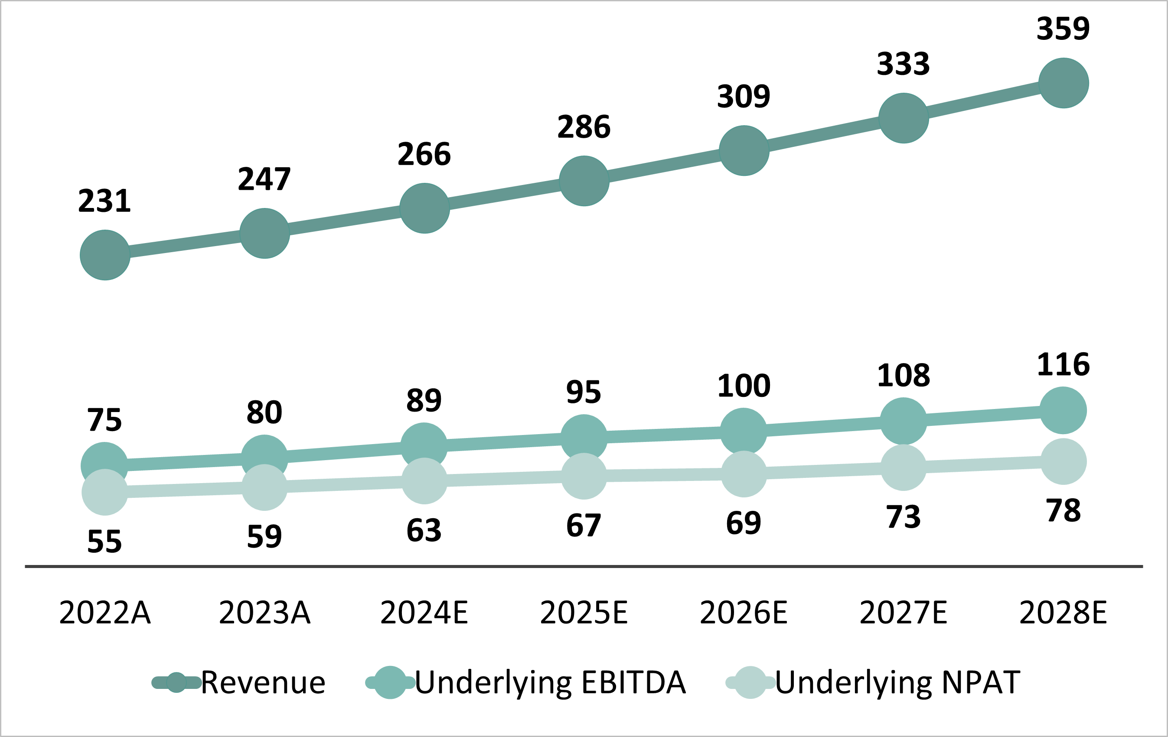
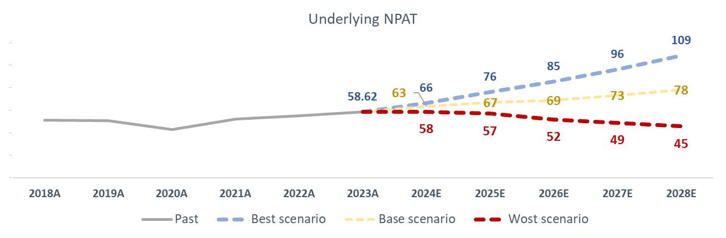
REVENUE PROJECTION
Growth (YoY) Forecast
Ratio Forecast
Average Growth (YoY) Forecast 2024-2028
Average Margin (%) Forecast 2024-2028
8% Revenue
7% EBIT
23% Net Profit Margin
33% EBITDA Margin
8% EBITDA
6% NPAT
Bull & Base & Bear Scenario Assumption
Revenue, EBITDA, NPAT forecast until 2028
Base
$0.77
($ per share)
$1.44 ($ per share)
$0.34 ($ per share)
Source: Company data
Business Model
Industry Positioning
Financial Analysis
Valuation-DCF
Sensitivity Analysis
ESG
Appendix Table
Notes:
Adding the revenue forecast for two segment, we expect a 8% YoY growth on EBITDA and revenue for the next five years. And 6% for NPAT.
Based on these forecast, we issue the hold recommendation with our DCF model’s 1 year target price $0.81. Cost of debt of 3.6%, and 10% for cost of equity, 6.3% on WACC and terminal growth of 4%.
DDM of 0.77 implied share price further confirmed our target price.

Slide 13
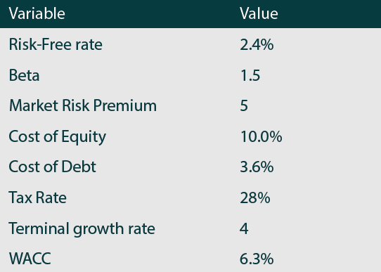
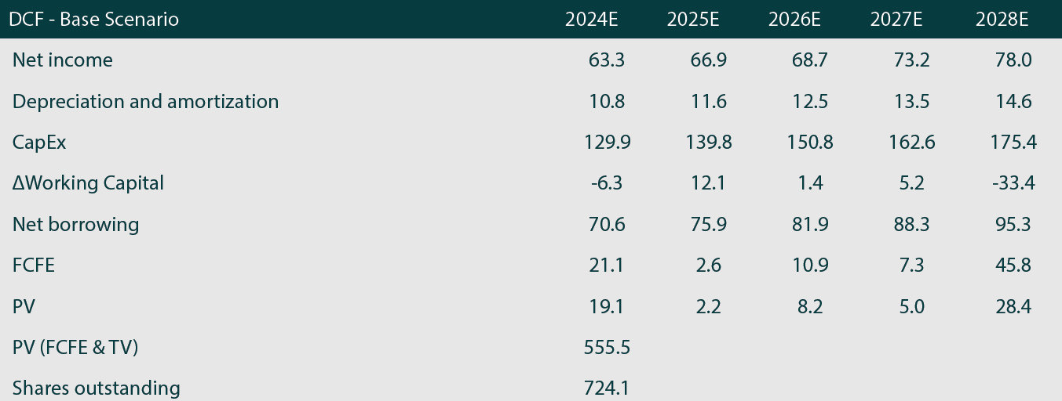
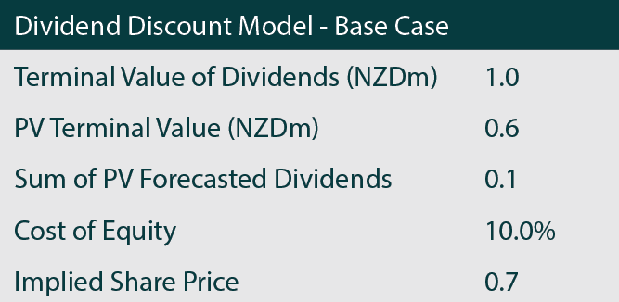
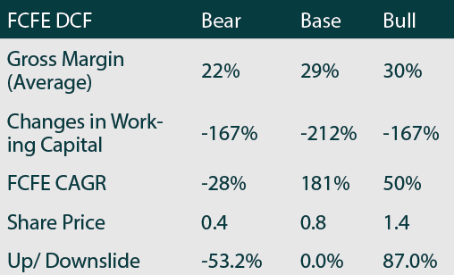
DISCOUNTED CASH FLOW MODEL (DCF)
Cost of Debt
Cost of Equity
WACC
Terminal Growth
Beta
(5Y monthly)
1 year Target Price
Upside
3.9%
NZ$ 0.81
3.6%
10.01%
6.3%
4%
1.53
Based on last close 0.77
The target share price based on DCF is confirmed by our DDM
%
7
Risk-free rate is based on 10-year T-bond monthly average for 10 year.
Up / Downside
Source: Company data
Business Model
Industry Positioning
Financial Analysis
Valuation-DCF
Sensitivity Analysis
ESG
Appendix Table
Notes:
Adding the revenue forecast for two segment, we expect a 8% YoY growth on EBITDA and revenue for the next five years. And 6% for NPAT.
Based on these forecast, we issue the hold recommendation with our DCF model’s 1 year target price $0.81. Cost of debt of 3.6%, and 10% for cost of equity, 6.3% on WACC and terminal growth of 4%.
DDM of 0.77 implied share price further confirmed our target price.

Slide 14




RELATIVE VALUATION
Peer Comparison
Key ratio compare with Peers
 | P/E (10 Oct 2023) | EV/EBITDA (2023) | ROE (2023) | ROIC (2023)
OCA | 33.4 | 24.3 | 1.62% | 1.80%
RYM | 17.2 | 14.1 | 6.4% | 4.10%
ARV | 10.7 | 28.5 | 6.0% | 2.80%
SUM | 8.5 | 19.9 | 12.3% | 9.60%
Industry average | 17.4 | 21.7 | 6.6% | 4.6%
Peer average
ROE (2023)
OCA Key Ratio Projection
1.6%
6.6%
Valuation Metrics | 2023A | 2024E | 2025E | 2026E | 2027E | 2028E
Share Outstanding (m) | 724 | 724 | 724 | 724 | 724 | 724
EV/EBITDA (x) | 15.8 | 15.3 | 15.4 | 15.8 | 15.7 | 15.7
EV/EBIT (x) | 17.8 | 17.4 | 17.5 | 18.0 | 18.0 | 18.0
P/E (x) | 9.4 | 8.5 | 8.6 | 8.8 | 8.7 | 8.6
Dividend Yield (%) | 4.0% | 4.3% | 4.3% | 4.2% | 4.3% | 4.3%
EPS (cps) | 8.1 | 8.7 | 9.2 | 9.5 | 10.1 | 10.8
Pay-out ratio (%) | 37% | 36% | 36% | 38% | 37% | 37%
ROIC (2023)
1.8%
4.6%
EV/EBITDA (2023)
21.7
24.3
P/E (10 Oct 2023)
17.4
33.4
Source: Company data
Business Model
Industry Positioning
Financial Analysis
Valuation-DCF
Sensitivity Analysis
ESG
Appendix Table
Notes:
key ratios compared to those of "big six"

Slide 15
DCF – SENSITIVITY ANALYSIS
2024(F) to 2028(F)
146 mil
10%
70 mil
Downside by 10%
Upside by 10%
4%
Business Model
Industry Positioning
Financial Analysis
Valuation-DCF
Sensitivity Analysis
ESG
Appendix Table
Notes:
*Capex, cost equity – left align

Slide 16
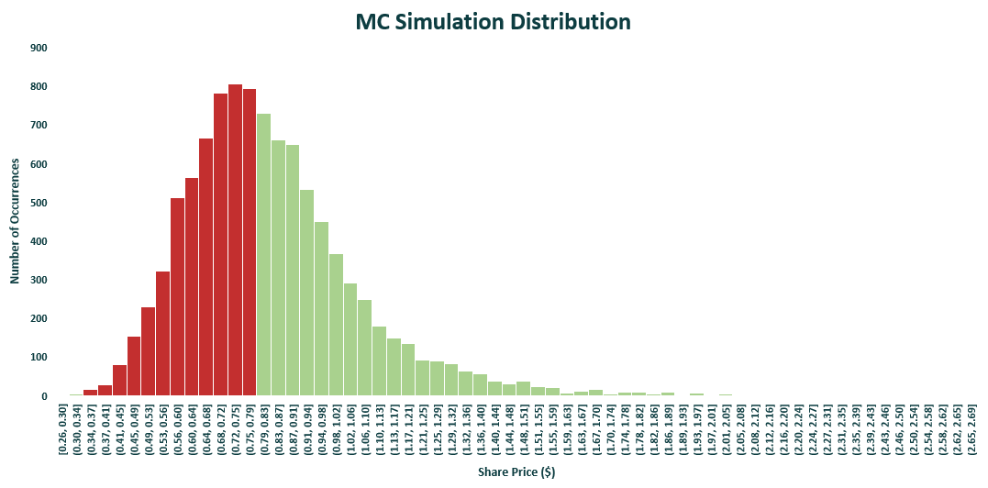
MONTE CARLO SIMULATION
0.77
44.6 % Probability
55.4% Probability
Simulating the Variations in NPAT and Cost of Equity
Source: company data
Business Model
Industry Positioning
Financial Analysis
Valuation-DCF
Sensitivity Analysis
ESG
Appendix Table
Notes:
Merge to

Slide 17
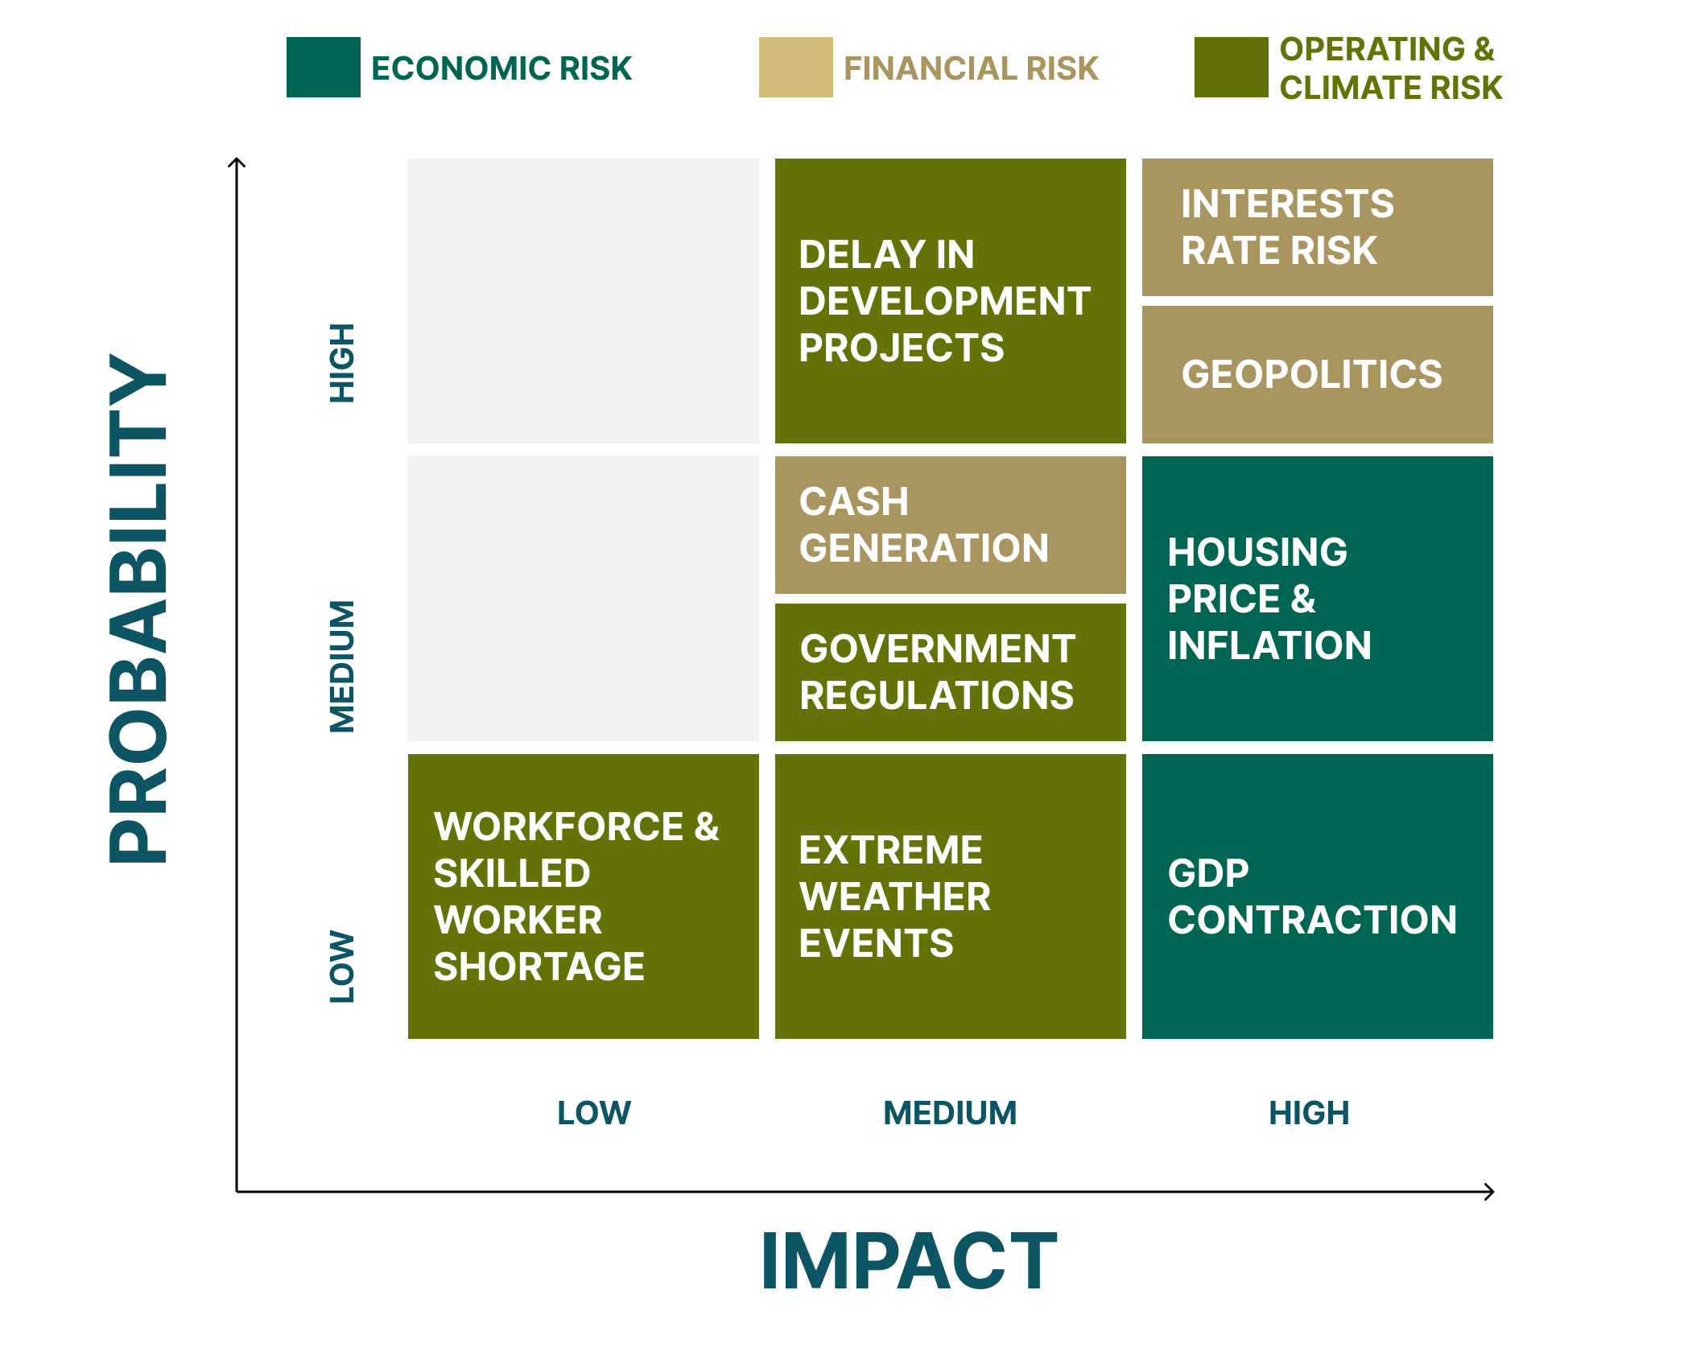
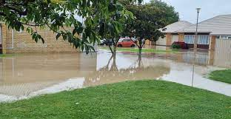
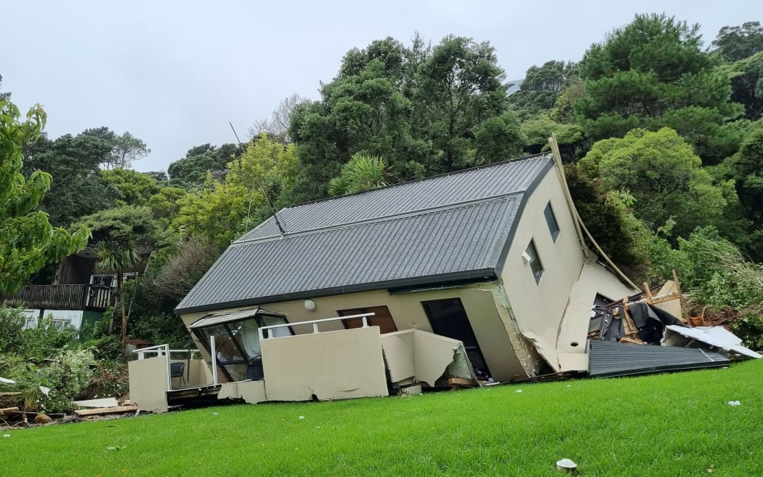
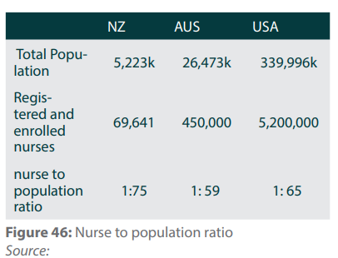
INVESTMENT RISKS
Extreme weather events
Auckland flooding Atawhai Retirement Village
Source: Annual Report 2023
Cyclone Gabrielle effect on Auckland
Source: RNZ
OCA insures properties against natural catastrophes.
Labour Shortage
OCA has a higher number of nurse to resident ratio
 | Number of care staff for residents
OCA | 1:1.33
RYM | 1:1.93
SUM | 1:3.08
ARV | 1:2.33
Government Regulations
Aged care government funded fee control by DHB
Retirement village share of capital gain issue
Source: Company data
Business Model
Industry Positioning
Financial Analysis
Valuation-DCF
Sensitivity Analysis
ESG
Appendix Table
Notes:
Company has

Slide 18

ESG – SOCIAL & GOVERNANCE
Governance
Environmental and Social
Financial Markets Authority Corporate Governance Principles and Guidelines :
Five-year Sustainability Loan (“SLL”)
Linking a 500 millions dollar bank loan with ESG standard
Oceania will pay a lower interest rate on the loan for meeting these SPTs but will have to pay higher interest if it does not meet these SPTs.
Principle | Criteria Met
Ethical Standards
Board Composition and Performance
Board Committees
Reporting and Disclose
Remuneration
Risk Management
Auditors
Shareholders Relations and Stakeholders Interest
Oceania’s Sustainability Performance Targets (“SPTs”):
Reduced greenhouse gas emissions.
Increase the diversion of construction waste from landfill.
Improve resident experience and wellbeing.
Business Model
Industry Positioning
Financial Analysis
Valuation-DCF
Sensitivity Analysis
ESG
Appendix Table
Notes:
Demand is quantified.

Slide 19
INVESTMENT THESIS
INVESTMENT THESIS
Aging population
Growing demand from aging population
Short-term business challenges
HOLD
1-year Target Price
NZ$ 0.81
Uncertainty in short-term environment
Business Model
Industry Positioning
Financial Analysis
Valuation-DCF
Sensitivity Analysis
ESG
Appendix Table
Notes:
Demand is quantified.

Slide 20
THANK YOU

Slide 21
APPENDIX
How OCR is changing revenue, EBITDA, EBIT, NPAT, Overall Revenue and CAPEX in the DCF model
Correlation With OCA Share Price
Correlation between OCA Share price with OCR & other factor
Valuation
Landbank
Debt Level Assumptions
Debt Levl Assumption – Explanation: High Debt Level
Bull, Base, Bear Scenario Assumption
Methodology of calculating NPAT
Methodology of calculating village revenue.
Methodology of calculating expenses, D&A, CAPEX
Why Market Share Of OCA is decreasing in Bear Scenario?
Regression Model For Unit Price Of Village Revenue Forecast
Monte Carlo Analysis
Sensitivity Analysis
WACC of OCA
Operation Matric
OCA Number Of Unit & Portfolio Weight
Past Numbers Analysis Of How Two Key Drivers In Business, Aged Care And Op Revenue Have Performed
Sales Performance
Peer Comparison
ESG
ESG SCORE
Scope 3 Emission Breakdown – Table
Net Capital Expenditure HealthCare forecast
Nurse Requirement Strategy
Related to OCR
How Change In Risk Free Rate Is Changing Cost Of Equity, WACC And Share Price
Business Model
Industry Positioning
Financial Analysis
Valuation-DCF
Sensitivity Analysis
ESG
Appendix Table

Slide 22
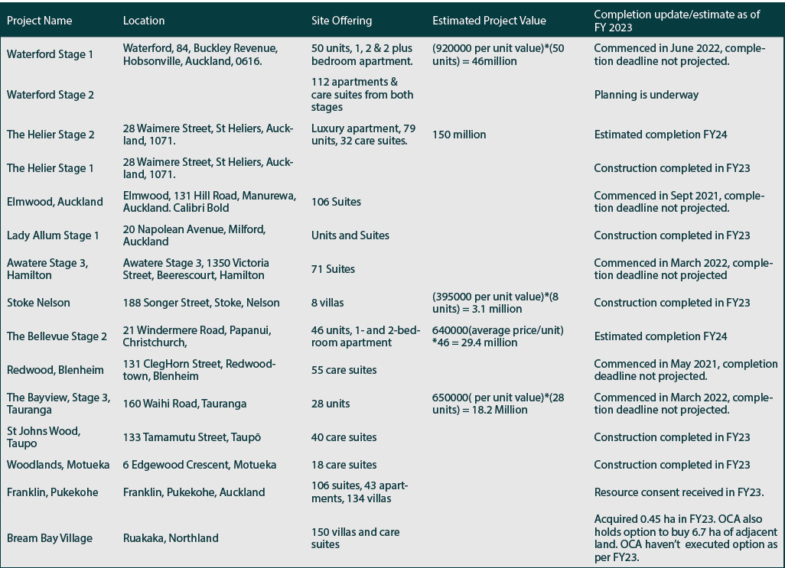
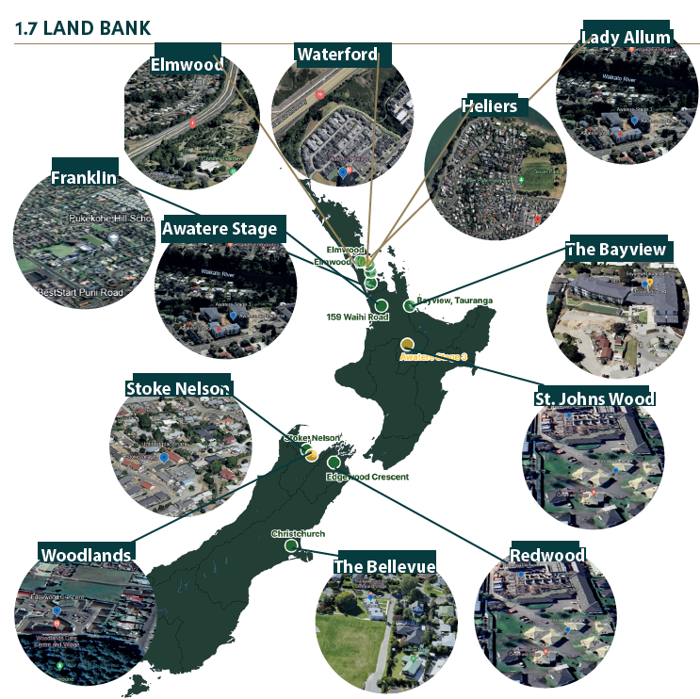
LANDBANK
Business Model
Industry Positioning
Financial Analysis
Valuation-DCF
Sensitivity Analysis
ESG
Appendix Table
Notes:
Demand is quantified.

Slide 23
DEBT LEVEL ASSUMPTIONS
 |  | 2017A | 2018A | 2019A | 2020A | 2021A | 2022A | 2023A | 2024E | 2025E | 2026E | 2027E | 2028E
Long-Term Debt |  | 93 | 167 | 269 | 326 | 327 | 380 | 554 | 648 | 750 | 860 | 978 | 1106
 | % of Total Asset | 10% | 15% | 19% | 21% | 17% | 17% | 22% | 24% | 25% | 26% | 27% | 27%
 | % Growth (YoY) |  | 79% | 61% | 21% | 1% | 16% | 46% | 17% | 16% | 15% | 14% | 13%
 |  | 2017A | 2018A | 2019A | 2020A | 2021A | 2022A | 2023A | 2024E | 2025E | 2026E | 2027E | 2028E
Net Increases/(decreases) in borrowings |  | -140 | 69 | 96 | 57 | 1 | 47 | 174 | 94.5 | 101.7 | 109.7 | 118.3 | 127.6
 | % of Revenue | -81% | 38% | 51% | 29% | 0% | 20% | 70% | 36% | 36% | 36% | 36% | 36%
 | % Growth (YoY) |  | -149% | 39% | -41% | -99% | 7481% | 270% | -46% | 8% | 8% | 8% | 8%
Proceeds from borrowings |  | 145 | 119.8 | 180.4 | 166.3 | 90.27 | 162.5 | 228.2 | 200.5 | 215.7 | 232.7 | 251.0 | 270.6
 | % of Revenue | 84% | 66% | 96% | 85% | 42% | 70% | 92% | 75% | 75% | 75% | 75% | 75%
Repayment of borrowings |  | -285.4 | -50.47 | -84.35 | -109.5 | -89.65 | -115.5 | -54.29 | -105.9 | -114.0 | -123.0 | -132.6 | -143.0
 | % of Revenue | 164% | 28% | 45% | 56% | 42% | 50% | 22% | 40% | 40% | 40% | 40% | 40%
Total debt was forecasted based the past six-year geomean of proceeds from borrowing to revenue (75%) and repayment of borrowing to revenue (40%).
So net increase in borrowing will increase as revenue increase.
Business Model
Industry Positioning
Financial Analysis
Valuation-DCF
Sensitivity Analysis
ESG
Appendix Table
Notes:
Demand is quantified.

Slide 24
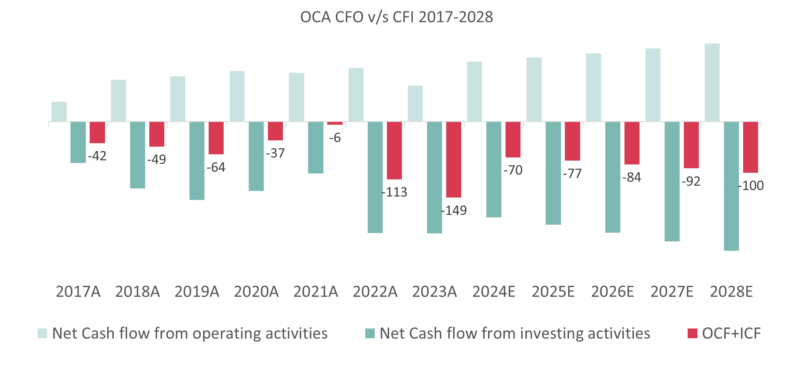
DEBT LEVL ASSUMPTION – Explanation: High Debt Level
Landbank
OCA has 1,000 units under construction, since it require high capital to support their expanding strategy, we believe OCA will keep the debt level high.
Cash generation
Since 2017, OCA has an ongoing trend where investing cash flow consistently exceed operating cash flow. In 2023, the gap came to -$149m. It means OCA’s cash gain from operation is not enough to support their investment, which means they need to borrow debt for their ongoing construction.
Growth of past total debt
We observed an 22% CAGR in past 7 years’ total debt. Based on the management guideline, they will maintain their gear ratio, which is 22% total debt to total asst in 2023.
Bond rolling over in FY27, 28
We believe to support OCA’s expanding strategy, OCA will roll over their 2 bonds ($225m), which will be matured in 2027, 2028.
Business Model
Industry Positioning
Financial Analysis
Valuation-DCF
Sensitivity Analysis
ESG
Appendix Table
Notes:
Demand is quantified.

Slide 25
The Key difference between Bear, Base and Worse Scenario.
1) The Growth Rate in Aged Population -> For Base, we took projected Population growth rate from JLL report which had a CAGR(2023-2028) of 4.24%.
For Best scenario, we took Growth rate projection of NYU Stern, this growth rate depends on projected Revenue Growth of hospitals (8.50%).
2) Occupancy Rate -> We took occupancy rate as per management guidance. We used a straight-line method to populate the occupancy rate for 5 years.
a) For Best scenario, we started at 90.40%(2024E) and 95%(2028E).
b) For Base scenario, we started at 90.40%(2024E) and 92%(2028E).
c) For Worse scenario, we started at 90.40%(2024E) and 88%(2028E).
Business Model
Industry Positioning
Financial Analysis
Valuation-DCF
Sensitivity Analysis
ESG
Appendix Table

Slide 26
The methodology of calculating reported NPAT
The methodology in calculations reported NPAT forecast is:
Village operating revenue & Care operating revenue -> We took from revenue projection
2) Fair value adjustment (investment property) -> We times the previous with growth rate of RBNZ expected house price inflation 1-year & 5-year
3) Other income *
4) Minus expenses*, depreciation*, interest expense* (Cost of debt), taxation*
5) Obtain the reported NPAT
* = Geomean common size %
Source: RBNZ | Mar-23 | Jun-23 | Sep-23 | GEOMEAN
Expected house price inflation 1-year (MEAN) | 0.001 | 0.006 | 0.016 | 0.004578857
Expected house price inflation 5-year (MEAN) | 0.044 | 0.062 | 0.081 | 0.011809082
Business Model
Industry Positioning
Financial Analysis
Valuation-DCF
Sensitivity Analysis
ESG
Appendix Table

Slide 27
Methodology of calculating village revenue
The methodology in village operating revenue forecast is:
GDP Growth -> We took GDP growth forecast for each year respectively
2) Life Expectancy -> We took data from Database.Earth for each year forecasted data respectively
3) Growth Population -> We took three data points for three different scenarios:
BULL -> NYU Stern data point of growth in population which is 8.94%
b) BASE -> We took JLL report datapoint of growth in population which is 4.94%
c) BEAR -> We took YoY growth model. The rationale for taking YoY growth is because in bear scenario YoY growth of market share is becoming negative. We wanted to factor in that degrowth in the model.
In this model all three factors have a linear relationship with village revenue growth, i.e. we are adding all the factors and all three are moving factors. The revenue increase YoY in Base and Bull scenario. In Bear scenario, village operating revenue decreases for 2026 and 2028.
Business Model
Industry Positioning
Financial Analysis
Valuation-DCF
Sensitivity Analysis
ESG
Appendix Table

Slide 28
Methodology of calculating expenses, D&A, CAPEX
 |  | 2017A | 2018A | 2019A | 2020A | 2021A | 2022A | 2023A | 2024E | 2025E | 2026E | 2027E | 2028E
Operating Expenses |  | 151.7 | 165.8 | 175.8 | 197.9 | 203.7 | 219.0 | 231.4 | 256.5 | 276.0 | 297.7 | 321.0 | 346.2
 | % of Revenue | 87% | 91% | 94% | 101% | 95% | 94% | 94% | 96% | 96% | 96% | 96% | 96%
Staff |  | 103.3 | 113.3 | 119.8 | 128.1 | 115.7 | 156.5 | 164.5 | 172.1 | 185.1 | 199.7 | 215.4 | 232.3
 | % of Revenue | 60% | 62% | 64% | 66% | 54% | 67% | 66% | 65% | 65% | 65% | 65% | 65%
Other expenses |  | 48.4 | 52.5 | 56.0 | 69.8 | 88.0 | 62.5 | 66.9 | 84.4 | 90.8 | 98.0 | 105.7 | 114.0
 | % of Revenue | 28% | 29% | 30% | 36% | 41% | 27% | 27% | 32% | 32% | 32% | 32% | 32%
Depreciation and amortisation |  | 7.9 | 8.8 | 9.5 | 14.5 | 14.9 | 18.6 | 17.9 | 21.0 | 22.6 | 24.4 | 26.3 | 28.4
 | % of Revenue | 5% | 5% | 5% | 7% | 7% | 8% | 7% | 8% | 8% | 8% | 8% | 8%
Payments for IP |  | -48 | -98 | -101 | -96 | -66 | -106 | -104 | -130 | -140 | -151 | -163 | -175
 | % of Revenue | 27% | 54% | 54% | 49% | 31% | 46% | 42% | 49% | 49% | 49% | 49% | 49%
The methodology forecast:
Expenses: Staff costs are 64.7% of revenue (geomean of past 7 years % to revenue); Other expenses are 31.8%of revenue (geomean of past 7 years % to revenue)
D&A is 8% of revenue (geomean of past 7 years % to revenue
CAPEX is the taken from the cash outflow of payment for investment property, which is 49% of revenue (geomean of past 7 years % to revenue)
Business Model
Industry Positioning
Financial Analysis
Valuation-DCF
Sensitivity Analysis
ESG
Appendix Table

Slide 29
REGRESSION MODEL FOR UNIT PRICE OF VILLAGE REVENUE FORECAST
1. Unit resale number is also forecasted to be in line with village segment revenue. Therefore, the same growth rate is used for the resale unit growth.
For the best scenerio, we assumption OCA's average development unit price will follow the past seven years CAGR (4.7%) continue to increase.
 |  | 2017 | 2018 | 2019 | 2020 | 2021 | 2022 | 2023 | CAGR
Avg Resale Unit Price |  | 0.31 | 0.34 | 0.35 | 0.35 | 0.35 | 0.42 | 0.45 | 4.7%
OCR |  | 1.75 | 1.75 | 1 | 0.25 | 0.75 | 4.25 | 5.5
 |  | 2024E | 2025E | 2026E | 2027E | 2028E
Avg Resale Unit Price |  | 0.45 | 0.469748 | 0.491998 | 0.515301 | 0.539708
OCR |  | 5.25 | 4.25 | 3.5 | 3.5 | 3.5
Intercept | 0.319586 | <= Result from regression.
OCR | 0.02183
Average development unit price forecast for the next five year:
Development price= 0.02183*OCR forecast + 0.319686
Average development unit price forecast for the next five year:
New sale price= 0.035747*OCR forecast + 0.48498
1. Unit development sale number is also forecasted to be in line with village segment revenue. Therefore, the same growth rate is used for the development sales unit growth.
For the best scenerio, we assumption OCA's average development unit price will follow the past six years CAGR (1.4%) continue to increase.
 |  | 2017 | 2018 | 2019 | 2020 | 2021 | 2022 | 2023 | CAGR
Avg development unit price |  | 0.44 | 0.63 | 0.62 | 0.50 | 0.43 | 0.64 | 0.68 | 1.4%
OCR |  | 1.75 | 1.75 | 1 | 0.25 | 0.75 | 4.25 | 5.5
 |  | 2024E | 2025E | 2026E | 2027E | 2028E
Avg development unit price |  | 0.684 | 0.694 | 0.703 | 0.713 | 0.723
OCR |  | 5.25 | 4.25 | 3.5 | 3.5 | 3.5
Intercept | 0.48498 | <= Result from regression.
OCR | 0.035747
Source: company data
Business Model
Industry Positioning
Financial Analysis
Valuation-DCF
Sensitivity Analysis
ESG
Appendix Table
Notes:
Demand is quantified.

Slide 30
How the forecast is changing basic factors in village revenue growth forecast
 |  |  | 2023 | 2024E | 2025E | 2026E | 2027E | 2028E
Total Aged Population |  |  | 383530 | 401210 | 418890 | 436570 | 454250 | 471930
Addressable Market (14%) |  |  | 53694 | 56169 | 58645 | 61120 | 63595 | 66070
Market Share |  |  | 2.0% | 7.5% | 7.5% | 7.6% | 7.6% | 7.6%
YoY Growth |  |  |  | 5.53% | 0.02% | 0.02% | 0.02% | 0.02%
Occupancy Rate |  |  | 90.40% | 90.72% | 91.04% | 91.36% | 91.68% | 92%
Residents |  |  | 4031 | 4227 | 4424 | 4622 | 4821 | 5022
Total Units |  |  | 4459 | 4659 | 4859 | 5059 | 5259 | 5459
Care Bed Units |  |  | 2773 | 2897 | 3021 | 3146 | 3270 | 3394
 |  | 2017 | 2018 | 2019 | 2020 | 2021 | 2022 | 2023
Units Delivered |  | 44 | 131 | 272 | 176 | 217 | 171 | 233
Best | Base | Worst
214 | 200 | 178
Business Model
Industry Positioning
Financial Analysis
Valuation-DCF
Sensitivity Analysis
ESG
Appendix Table

Slide 31
Why Market Share Of OCA is decreasing in Bear Scenario?
Because the Occupancy Rate in Bear Scenario decreases which leads to a slowing impact on the number of residents coming in, hence the loss in market share.
Market Share is = No of Residents/Total Addressable market.
We took TAM as constant but the number of residents coming slows down. Which leads to YoY growth of market share becoming negative.
The Occupancy rate is as per management guidance. It differs for all three scenarios. In the bear scenario, the occupancy rate becomes less.
The Occupancy rate is explained in next slide.
Bull & Base & Bear Scenario Assumption
Base
$0.77
$1.44
$0.34
GDP Growth Rate Forecast (from NZ Treasury)
Life Expectancy Growth Rate
NZ Average life expectancy Increase around 0.2% (YoY)
Life Expectancy Growth Rate (1.5% YoY growth 2024-2025)
Hospitals/Healthcare Facilities Growth Rate Projection 8% (YoY) Based on Stern NYU
Aged population Forecast Growth 4.24% (YoY) from 2023-2028
Based on JIL.NZ
YoY growth on negative growth of market share.
Based on occupancy rate of 88% in 2028.
Business Model
Industry Positioning
Financial Analysis
Valuation-DCF
Sensitivity Analysis
ESG
Appendix Table

Slide 32
How change in Risk free Rate is changing Cost of equity and WACC and changing in Share price
2024(F) up to 2028(F)
WACC Calculation | Sep-23
Weight of Debt and Equity | (NZ$ million)
Number of shares | 724.10 (4 Sept 2023)
current share price | 0.76 (4 Sept 2023)
market capitalisation | 550.32 (4 Sept 2023)
Net debt | 551.0
% debt | 50.03%
% equity | 49.97%
Cost of Debt
Interest expense | 19.873
Cost of Debt | 3.61%
Cost of Equity
Beta | 1.53
Risk Free Rate | 2.35%
Market Risk Premium | 5.00%
Cost of Equity | 10.01%
WACC | 6.30%
% increase/decrease in Risk-Free Rate | Risk-Free Rate | WACC | Cost of Equity | Share Price
 | 2.35% | 6.30% | 10.01% | 0.77
+0.5% | 2.85% | 6.55% | 10.51% | 0.70
+0.25% | 2.60% | 6.42% | 10.26% | 0.73
-0.25% | 2.10% | 6.17% | 9.76% | 0.80
-0.5% | 1.85% | 6.05% | 9.51% | 0.85
Increase/decrease 0.5% in risk free rate will increase/decrease 0.25% in WACC and increase/decrease 0.5% in cost of equity
Increase/decrease 0.25% in risk free rate will Increase/decrease 0.12% in WACC and 0.25% in cost of equity
Business Model
Industry Positioning
Financial Analysis
Valuation-DCF
Sensitivity Analysis
ESG
Appendix Table
Notes:
Sensitivity relationship with the stock price

Slide 33
How OCR is changing revenue, EBITDA, EBIT, NPAT, Overall Revenue and CAPEX in the DCF model
 | OCR (+0.5) | OCR | OCR (-0.5)
Revenue Village | 130.42 | 128.63 | 126.83
 | +1.4% |  | -1.4%
underlying EBITDA | 102.83 | 101.43 | 100.04
 | +1.4% |  | -1.4%
Underlying EBIT | 90.24 | 88.85 | 87.45
 | +1.6% |  | -1.6%
underlying NPAT | 71.41 | 70.02 | 68.62
 | +2.0% |  | -2.0%
OVERALL REVENUE | 377.01 | 375.21 | 373.41
 | +0.5% |  | -0.5%
CAPEX | 151.68 | 151.68 | 151.68
 | 0% |  | 0%
SHARE PRICE | 0.80 | 0.77 | 0.74
 | +4.0% |  | -4.2%
2024(F) up to 2028(F)
The CAPEX is constant. But WACC is increasing. Which leads to decrease in Share price.
As we can see with increase in OCR, Revenue, EBITDA, EBIT, NPAT and overall revenue is increasing with increase in OCR. And if we don't change cost of equity in this model, the share price will also increase.
But increase in OCR will increase cost of equity and cost of debt and WACC. Hence the overall impact of OCR change will lead to decrease in Share price. The OCR have linear relationship with our model revenue and EBITDA projections and an inverse relationship with share price.
Please note – the increase in share price is here because we have not changed WACC in this modelling.
Business Model
Industry Positioning
Financial Analysis
Valuation-DCF
Sensitivity Analysis
ESG
Appendix Table
Notes:
Sensitivity relationship with the stock price

Slide 34
KET RATIOS
2024(F) up to 2028(F)
Valuation Metrics | 2022A | 2023A | 2024E | 2025E | 2026E | 2027E | 2028E
Share Outstanding (m) | 705 | 724 | 724 | 724 | 724 | 724 | 724
EV/EBITDA (x) | 14.6 | 15.8 | 15.3 | 15.4 | 15.8 | 15.7 | 15.7
EV/EBIT (x) | 16.9 | 17.8 | 17.4 | 17.5 | 18.0 | 18.0 | 18.0
P/E (x) | 13.5 | 9.4 | 8.5 | 8.6 | 8.8 | 8.7 | 8.6
Dividend Yield (%) | 2.6% | 4.0% | 4.3% | 4.3% | 4.2% | 4.3% | 4.3%
EPS (cps) | 7.8 | 8.1 | 8.7 | 9.2 | 9.5 | 10.1 | 10.8
Pay-out ratio (%) | 35% | 37% | 36% | 36% | 38% | 37% | 37%
Key Ratios | 2022A | 2023A | 2024E | 2025E | 2026E | 2027E | 2028E
ROA (%) | 2.6% | 2.5% | 2.5% | 2.4% | 2.2% | 2.1% | 2.0%
ROE (%) | 5.8% | 6.1% | 6.2% | 6.0% | 5.7% | 5.6% | 5.5%
ROIC (%) | 6.7% | 7.2% | 7.5% | 7.6% | 7.6% | 7.7% | 7.8%
Net Profit Margin (%) | 24% | 24% | 24% | 23% | 22% | 22% | 22%
EBITDA Margin (%) | 32% | 32% | 33% | 33% | 32% | 32% | 32%
EBIT Margin (%) | 28% | 29% | 29% | 29% | 28% | 28% | 28%
Capex to total revenue (%) | 46% | 42% | 49% | 49% | 49% | 49% | 49%
Key Drivers | 2022A | 2023A | 2024E | 2025E | 2026E | 2027E | 2028E
Sales- new units (# ) | 184 | 128 | 135 | 144 | 155 | 167 | 180
Sales- resold units (#) | 266 | 280 | 296 | 315 | 339 | 365 | 393
Development margin (%) | 28% | 37% | 32% | 33% | 33% | 32% | 32%
Resale margin (%) | 21% | 22% | 25% | 24% | 24% | 24% | 23%
Villa EBITDA | 79 | 83 | 90 | 95 | 99 | 105 | 112
Care EBITDA | 20 | 21 | 23 | 24 | 25 | 26 | 27
Occupancy % | 92% | 90% | 91% | 91% | 91% | 92% | 92%
Business Model
Industry Positioning
Financial Analysis
Valuation-DCF
Sensitivity Analysis
ESG
Appendix Table
Notes:
Sensitivity relationship with the stock price

Slide 35
KEY RATIOS EXPLATIONARION
ROE is decreasing in the forecast, but the ROIC is increasing, why?
A: Because the OCA total debt level is increasing, leading the interest expenses going up, which will drag down the ROE. Also, the common equity stay constant in our forecast.
EV/EBITDA is lower than EV/EBIT, why?
A: Because OCA has high fixed asset, which lead to higher depreciation and higher EBITDA compared with EBIT.
Business Model
Industry Positioning
Financial Analysis
Valuation-DCF
Sensitivity Analysis
ESG
Appendix Table
Notes:
Demand is quantified.

Slide 36
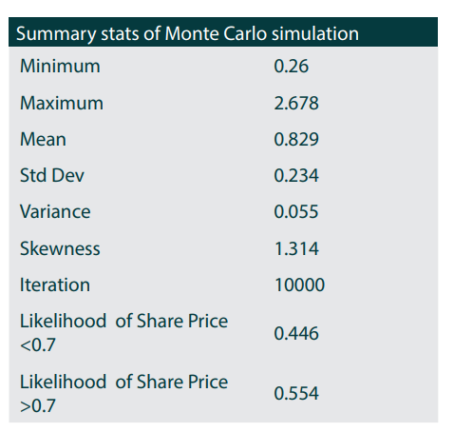
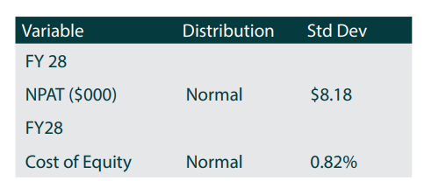
MONTE CARLO ANALYSIS
ROE is decreasing in the forecast, but the ROIC is increasing, why?
A: Because the OCA total debt level is increasing, leading the interest expenses going up, which will drag down the ROE. Also, the common equity stay constant in our forecast.
1) We calculate the mean and standard deviation based on 2017 to 2023 data for two factor influencing DCF model which is cost of equity and NPAT
2) Use random excel equation to generate many random sample for each input variable.
3) Incorporate the random samples into DCF model and connect the share price to the table for iterations
4) Repeat the model for a 10,000 iterations to create a distribution of possible outcomes.
5) Collect and record the results of each iterations
EV/EBITDA is lower than EV/EBIT, why?
A: Because OCA has high fixed asset, which lead to higher depreciation and higher EBITDA compared with EBIT.
Business Model
Industry Positioning
Financial Analysis
Valuation-DCF
Sensitivity Analysis
ESG
Appendix Table
Notes:
Demand is quantified.

Slide 37
SENSITIVITY ANALYSIS
 |  |  |  | Terminal Growth rate
 |  | Worst | Worst | Base | Best | Best
 |  | 3.2% | 3.6% | 4.0% | 4.4% | 4.8%
 | 8.11% | 0.99 | 1.08 | 1.18 | 1.30 | 1.45
 | 9.01% | 0.82 | 0.88 | 0.94 | 1.02 | 1.11
Cost of Equity | 10.01% | 0.68 | 0.72 | 0.77 | 0.82 | 0.88
 | 11.0% | 0.58 | 0.61 | 0.64 | 0.68 | 0.72
 | 12.1% | 0.50 | 0.52 | 0.54 | 0.57 | 0.59
ROE is decreasing in the forecast, but the ROIC is increasing, why?
A: Because the OCA total debt level is increasing, leading the interest expenses going up, which will drag down the ROE. Also, the common equity stay constant in our forecast.
1) The input variables are the key drivers in DCF model
- terminal growth rate, cost of equity, capex and net income
2) The base case is the is represent the current conditions.
3) The 10% increase or decrease based on the previous number for every variables
4) Use the DCF model to calculate the outcomes for each scenarios, based in adjusted variables
5) Compare differences and calculate the growth in outcomes between base case and the various scenarios
6) Present the result using tornado diagram
EV/EBITDA is lower than EV/EBIT, why?
A: Because OCA has high fixed asset, which lead to higher depreciation and higher EBITDA compared with EBIT.
 |  |  |  | Capex
 |  | Best | Best | Base | Worst | Worst
 |  | -15% | -10% | 0% | 10% | 15%
 | -15% | 1.05 | 0.88 | 0.54 | 0.20 | 0.03
 | -10% | 1.12 | 0.95 | 0.62 | 0.28 | 0.11
Net income | 0% | 1.28 | 1.11 | 0.77 | 0.43 | 0.26
 | 10% | 1.43 | 1.26 | 0.92 | 0.58 | 0.41
 | 15% | 1.50 | 1.34 | 1.00 | 0.66 | 0.49
Business Model
Industry Positioning
Financial Analysis
Valuation-DCF
Sensitivity Analysis
ESG
Appendix Table
Notes:
Demand is quantified.

Slide 38
OCA NUMBER OF UNIT & PORTFOLIO WEIGHT
2024(F) up to 2028(F)
OCA’s number of care suite has increased 308% since 2017
The number of care bed has decreased 41% since 2017.
The number of village has increased 72% since 2017.
OCA has been increasing their care suite and villages, decreasing their care bed. We see a trend that OCA is increasing their premium units.
Business Model
Industry Positioning
Financial Analysis
Valuation-DCF
Sensitivity Analysis
ESG
Appendix Table
Notes:
Sensitivity relationship with the stock price

Slide 39
Past Numbers Analysis of how two key drivers in business, Aged Care and Op Revenue have performed.
financial year | Growth% | 2017A | 2018A | 2019A | 2020A | 2021A | 2022A | 2023A | 2024E | 2025E | 2026E | 2027E | 2028E
Revenue |  | 174 | 183 | 187 | 195 | 215 | 232 | 247 | 266 | 286 | 309 | 333 | 359
 | % Growth (YoY) |  | 5% | 3% | 4% | 10% | 8% | 7% | 7% | 8% | 8% | 8% | 8%
Village operating revenue |  | 21 | 23 | 26 | 31 | 37 | 44 | 52 | 55 | 59 | 63 | 68 | 73
153% | % of Revenue | 12% | 13% | 14% | 16% | 17% | 19% | 21% | 21% | 21% | 21% | 20% | 20%
 | % Growth (YoY) |  | 11% | 12% | 20% | 19% | 19% | 20% | 6% | 6% | 8% | 8% | 8%
Care operating revenue |  | 153 | 160 | 162 | 164 | 179 | 189 | 195 | 211 | 227 | 245 | 265 | 285
28% | % of Revenue | 88% | 87% | 86% | 84% | 83% | 81% | 79% | 79% | 79% | 79% | 80% | 80%
 | % Growth (YoY) |  | 4% | 1% | 2% | 9% | 6% | 3% | 8% | 8% | 8% | 8% | 8%
The absolute increase in %age in aged care revenue in the past 7 years(2017 – 2023) is 28%. The number 28% is without inflation adjustment.
The absolute increase in %age in Village Op Revenue in the past 7 years(2017 – 2023) is 153%. The number 28% is without inflation adjustment.
The growth rate (YoY) we forecast is 8% for aged acre and 6-8% for retirement village.
The Methodology for village operating revenue in the model is as follows.
Source: company data
Business Model
Industry Positioning
Financial Analysis
Valuation-DCF
Sensitivity Analysis
ESG
Appendix Table
Notes:
Demand is quantified.

Slide 40
SALES PERFORMANCE
Sales Performance ($NZDk) | 2017 | 2018 | 2019 | 2020 | 2021 | 2022 | 2023
Average Apartment price per unit | 379 | 509 | 592 | 684 | 883 | 868 | 1012
Average Villa price per unit | 378 | 381 | 406 | 433 | 459 | 524 | 537
Average Care Suit price per unit | 202 | 239 | 241 | 256 | 272 | 306 | 324
Sales Performance ($NZDk) | 2017 | 2018 | 2019 | 2020 | 2021 | 2022 | 2023
Total sale units | 203 | 280 | 310 | 408 | 434 | 450 | 408
Resale units (#) | 151 | 180 | 177 | 202 | 212 | 266 | 280
Resale units (#)- Apartment | 32 | 26 | 28 | 35 | 34 | 37 | 45
Resale units (#)- Villa | 57 | 75 | 55 | 45 | 54 | 55 | 53
Resale units (#)- Care Suit | 62 | 79 | 94 | 122 | 124 | 174 | 182
New Sale units (#) | 52 | 100 | 133 | 206 | 222 | 184 | 128
New Sale units (#)- Apartment | 20 | 47 | 53 | 59 | 67 | 92 | 54
New Sale units (#)- Villa | 17 | 26 | 23 | 19 | 40 | 26 | 0
New Sale units (#)- Care Suit | 15 | 27 | 57 | 128 | 115 | 66 | 74
Source: company data
Business Model
Industry Positioning
Financial Analysis
Valuation-DCF
Sensitivity Analysis
ESG
Appendix Table
Notes:
Demand is quantified.

Slide 41
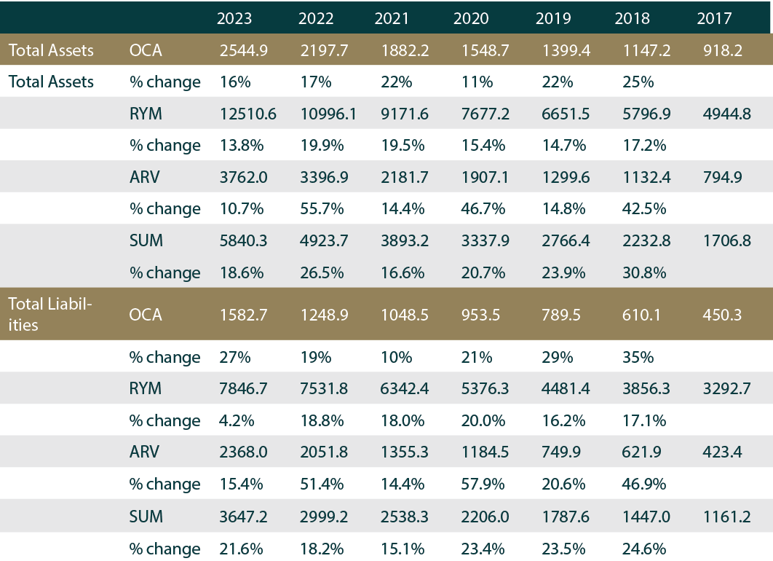
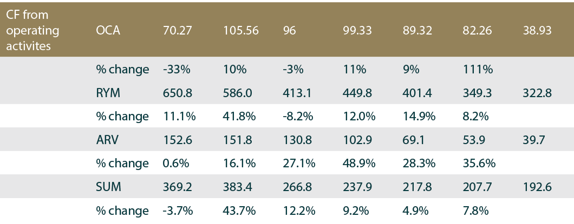
Peer Comparison – Financial Analysis
OCA’S total asset is $2500m in 2023,which is the lowest within the peers.
OCA’s total liability is $1600m in 2023, which is the lowest within the peers.
OCA’s OCF decrease 33% in 2023.
Source: company data
Business Model
Industry Positioning
Financial Analysis
Valuation-DCF
Sensitivity Analysis
ESG
Appendix Table
Notes:
Demand is quantified.

Slide 42
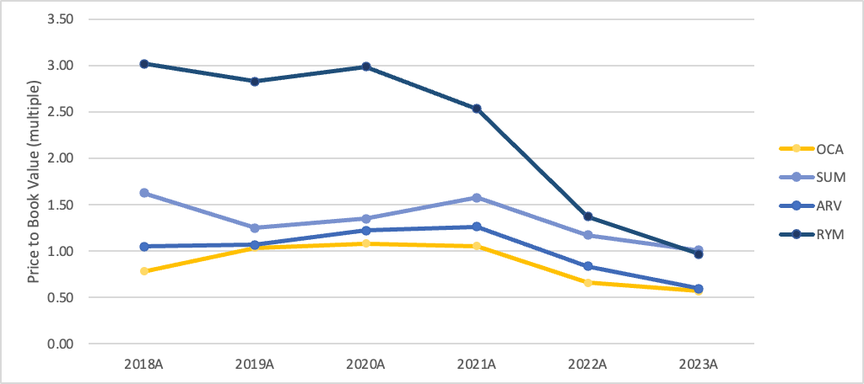
Price To Book Value
Price to Book Value | 2018A | 2019A | 2020A | 2021A | 2022A | 2023A | average
Marker price per share | 1.2 | 1.0 | 1.1 | 1.4 | 1.0 | 0.8
Book Value per share | 1.5 | 1.0 | 1.0 | 1.4 | 1.5 | 1.4
OCA | 0.8 | 1.0 | 1.1 | 1.1 | 0.7 | 0.6 | 0.9
Marker price per share | 7.1 | 6.2 | 8.0 | 13.2 | 11.1 | 10.0
Book Value per share | 4.3 | 5.0 | 5.9 | 8.4 | 9.4 | 9.9
SUM | 1.6 | 1.2 | 1.3 | 1.6 | 1.2 | 1.0 | 1.3
Marker price per share | 1.2 | 1.4 | 1.6 | 1.9 | 1.6 | 1.1
Book Value per share | 1.2 | 1.3 | 1.3 | 1.5 | 1.9 | 1.9
ARV | 1.0 | 1.1 | 1.2 | 1.3 | 0.8 | 0.6 | 1.0
Marker price per share | 11.7 | 12.3 | 13.7 | 14.3 | 9.4 | 6.5
Book Value per share | 3.9 | 4.3 | 4.6 | 5.7 | 6.9 | 6.8
RYM | 3.0 | 2.8 | 3.0 | 2.5 | 1.4 | 1.0 | 2.3
Price to book value of OCA have seen a decreasing trend from 2020 to 2023.
Currently P/B is less than one, OCA is under valued.
Business Model
Industry Positioning
Financial Analysis
Valuation-DCF
Sensitivity Analysis
ESG
Appendix Table

Slide 43
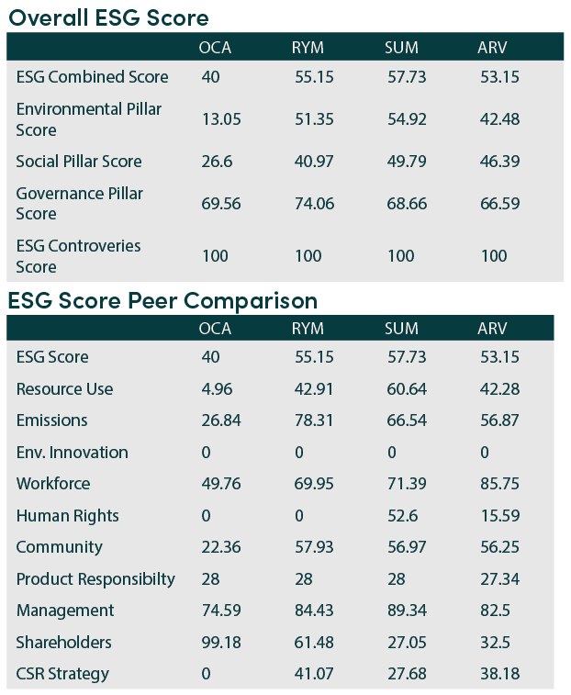
ESG SCORE
Source: company data
Business Model
Industry Positioning
Financial Analysis
Valuation-DCF
Sensitivity Analysis
ESG
Appendix Table
Notes:
Demand is quantified.

Slide 44
Scope 3 Emission Breakdown – Table
Scope 3 Emission Breakdown - Table
Scope 3 Emissions | 2023 | 2022 | Impact | Remarks
Purchased goods and services | 14 130 | 13 035 | Negative | This statement pertains to the acquisition, production, and transportation of goods and services by the reporting company within the current year. The category of "purchased goods and services" encompasses emissions linked to the goods and services bought by the organization.
Capital good | 16 990 | 30 235 | Positive | The OCA measures emissions from the start of new developments when they are finished.
Fuel and Energy related activities | 1 157 | 1 129 | Negative | The types of emissions in the category: upstream emission of purchased fuels and purchased electricity, transmission and distribution losses which is energy wasted during the delivery of electricity from power plants.
Waste generated in operations | 1 494 | 1 340 | Negative | Emission generated from disposal and treatment of waste generated by OCA. E.g.: solid waste, landfilled, wastewater
Employee commuting | 3 535 | 3 224 | Positive | The number increase as OCA hires more employees and contractors
Downstream leased assets | 649 | 845 | Positive | These are the emission generated from operation of OCA and leased to other entities in the reporting year
Source: National GRID
Business Model
Industry Positioning
Financial Analysis
Valuation-DCF
Sensitivity Analysis
ESG
Appendix Table

Slide 45
SUSTAINABLE LOAN
ANZ NZ Institutional wrote 22 sustainable finance deals in FY22 equal more than NZD$10 billion towards sustainability.
Ocenia’s Sustainability Performance Target: s (“SPTs”):
1) The reduction for the greenhouse gas emissions in line with targets approved by the International Science Based Targets initiative.
2) decrease the diversion of construction waste from landfill.
3) Improve resident experience and wellbeing.
Social
Resident experience
Clinical and wellbeing assessment data for care residents
Net Promoter Score (NPS) or resident satisfaction surveys
Business Model
Industry Positioning
Financial Analysis
Valuation-DCF
Sensitivity Analysis
ESG
Appendix Table

Slide 46
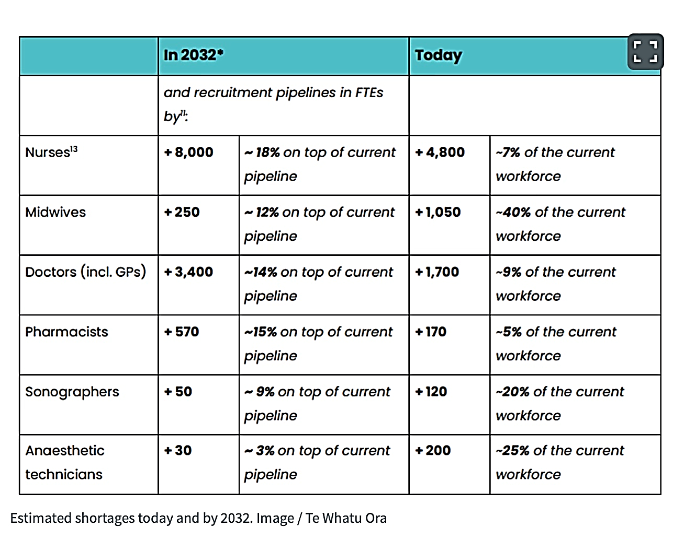
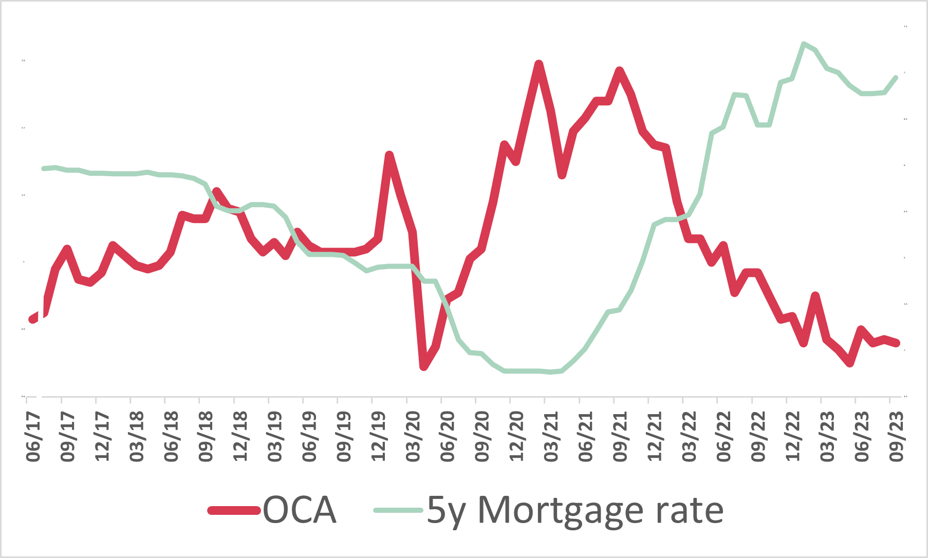
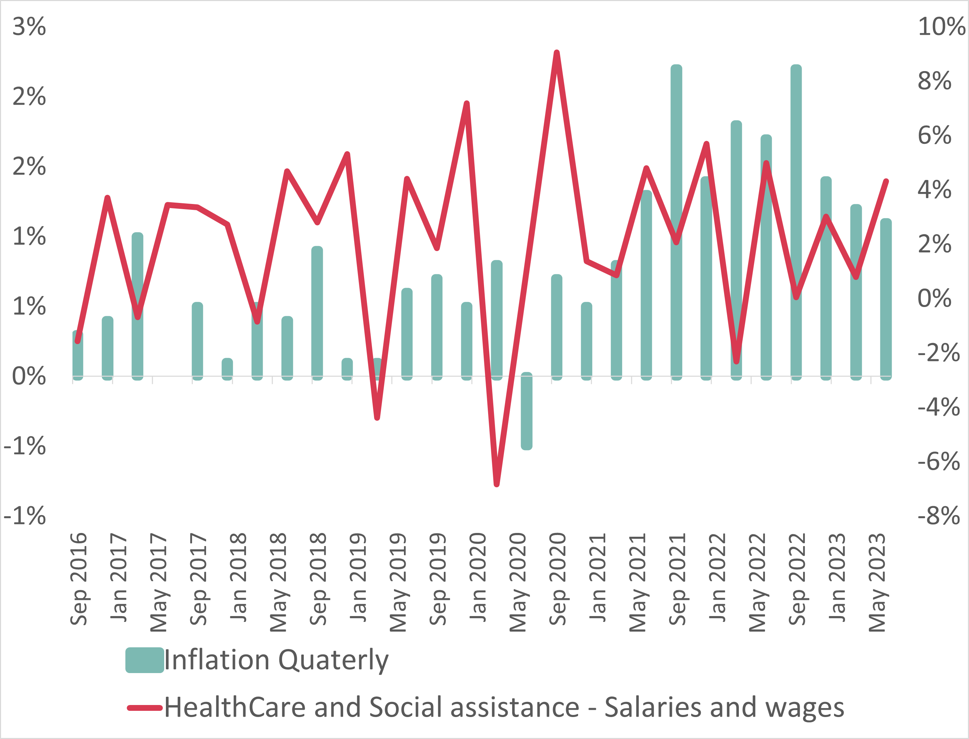
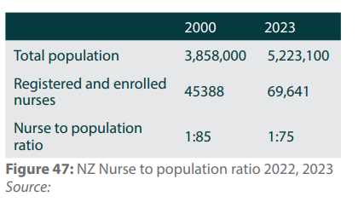
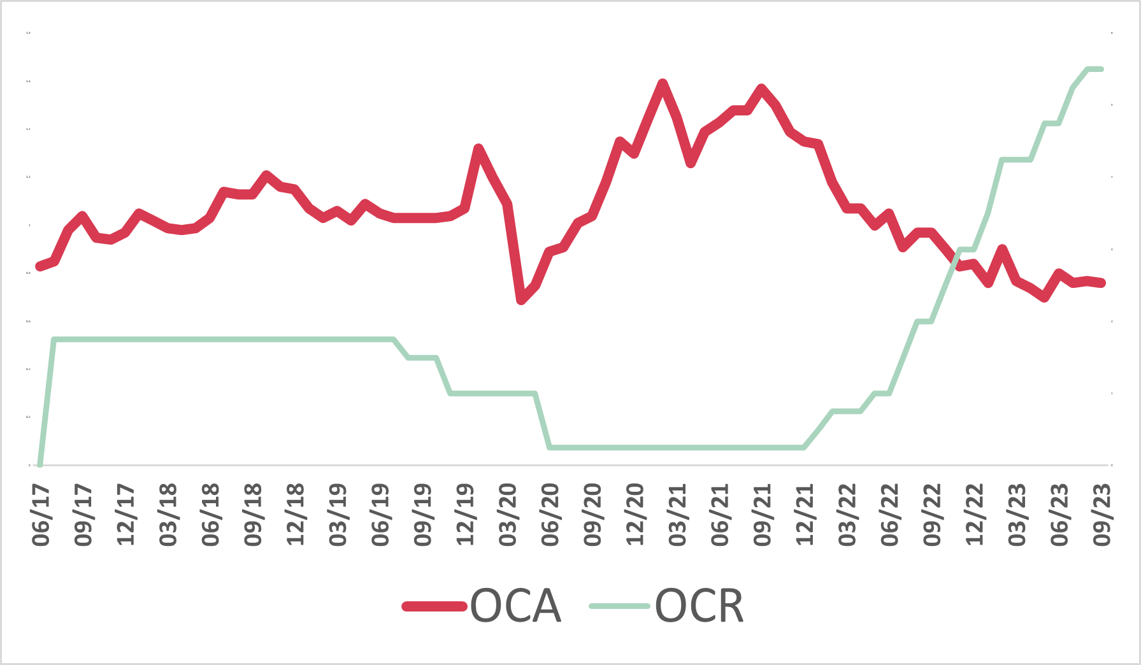



OCA share price compared with 5y mortgage rate 2017-2023
NURSE REQUIREMENT STRATEGY
New Zealand Nurse to Population ratio
ESG
(1 line they have loan attach to it, maintain the ESG standard, penalize and discount as the ESG standard)
Nursing Training School
OCA share price compared with OCR 2017-2023
Forged government relationship
Worker shortage + extreme weather events + geopolitics
Nursing Training School
Source: NZ Herald
Business Model
Industry Positioning
Financial Analysis
Valuation-DCF
Sensitivity Analysis
ESG
Appendix Table
Notes:
Demand is quantified.

Slide 47
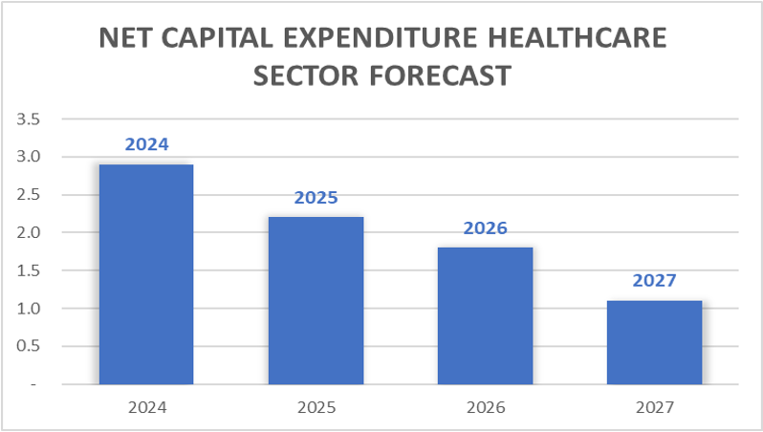
Net Capital Expenditure HealthCare forecast
The government published this data in the recent gov report. The Government have forecasted to less spending of healthcare sector in coming months.
Business Model
Industry Positioning
Financial Analysis
Valuation-DCF
Sensitivity Analysis
ESG
Appendix Table

Slide 48





Oca’s Debt Ratio Is Lower Than Its Peers
Source: company data
Business Model
Industry Positioning
Financial Analysis
Valuation-DCF
Sensitivity Analysis
ESG
Appendix Table
Notes:
Demand is quantified.

Slide 49


WACC of OCA

Slide 50
Beta of OCA and Peers
WACC of OCA and Peers
Summerset | Arvida | Ryman | Oceania
8.34% | 5.47% | 8.97% | 6.30%
Summerset | Arvida | Ryman | Oceania
1.70 | 1.18 | 1.86 | 1.53
Cost of Debt of OCA and Peers
Cost of Equity of OCA and Peers
Summerset | Arvida | Ryman | Oceania
5% | 2.06% | 5.18% | 3.61%
Summerset | Arvida | Ryman | Oceania
10.01% | 10.85% | 8.24% | 11.67%
Cost of Equity is lowest for Ryman. Because debt is lowest in ryman.

Slide 51
Capital Structure -> OCA and its peers
 | Summerset | Arvida | Ryman | Oceania
Total Debt | 1273.779 | 622.82 | 2316.86 | 551
Total Mcap | 2402.63 | 895.41 | 4504.05 | 550.32
% Debt in Total Capital | 34.64% | 41.02% | 33.97% | 50.03%
% Equity in Total Capital | 65.35% | 58.98% | 66.03% | 49.97%

Slide 52
Impact Of Housing Inflation(HPI) in OCA Stock Price. Correlation -> -64.285%
Business Model
Industry Positioning
Financial Analysis
Valuation-DCF
Sensitivity Analysis
ESG
Appendix Table

Slide 53
Impact Of CCCI in OCA Stock Price Impact of construction cost index Correlation -> -0.713%
Business Model
Industry Positioning
Financial Analysis
Valuation-DCF
Sensitivity Analysis
ESG
Appendix Table

Slide 54
CCCI v/s Development Margin. Correlation -> -71.08%
Business Model
Industry Positioning
Financial Analysis
Valuation-DCF
Sensitivity Analysis
ESG
Appendix Table

Slide 55
Quarterly Inflation v/s Healthcare Sector %age wage change. Correlation -> -1.264%.
Business Model
Industry Positioning
Financial Analysis
Valuation-DCF
Sensitivity Analysis
ESG
Appendix Table

Slide 56
Quarterly Inflation and Healthcare Sector Salaries. The correlation is +ve.
Business Model
Industry Positioning
Financial Analysis
Valuation-DCF
Sensitivity Analysis
ESG
Appendix Table

Slide 57
OCA Stock Price v/s 5Y Mortgage Rate. Correlation -> -0.6135. A very strong –ve correl.
Business Model
Industry Positioning
Financial Analysis
Valuation-DCF
Sensitivity Analysis
ESG
Appendix Table

Slide 58
OCA Stock v/s 10Y Bond Yield. Correlation -> -0.47875.
Business Model
Industry Positioning
Financial Analysis
Valuation-DCF
Sensitivity Analysis
ESG
Appendix Table

Slide 59
OCA Stock v/s OCR. Correlation -> -0.69478
Business Model
Industry Positioning
Financial Analysis
Valuation-DCF
Sensitivity Analysis
ESG
Appendix Table

Slide 60
OCA v/s OCR & RFR
We observe in the above slides that OCA stock has a negative correlation with OCR and 10-year bond yield.
We have used a 10-year bond yield as Risk-free Rate in the cost of equity calculation. We can deduce, as 10 year bond yield increases, the cost of equity increases, and stock price decreases given the strong negative correlated between the two.
Business Model
Industry Positioning
Financial Analysis
Valuation-DCF
Sensitivity Analysis
ESG
Appendix Table

